Slide 1

Programming
Enterprise Software Development
Language: Java, Typescript, SQL
Framework: Spring Boot
Others: git, Agile, microservices, Redis
Distributed System
Selim Reza , Senior Software Developer
Technical Assistance to Support Implementation of the Bangladesh PFM Reform Strategic Plan

Slide 2
The European Union (EU) is a unique economic and political union between 27 European countries.
The PFM Reform Strategy (PFMRS):
The PFM Reform Strategy (PFMRS) 2016-2021 was adopted in August 2016 and, unlike previous plans, is a new and quite extensive Strategy that follows a holistic approach.

Slide 3
The EU Projects in Bangladesh
Supporting Human Rights Defenders Working for Women’s and Girls’ Rights in Bangladesh.
European Regional Development Fund – regional and urban development.
European Social Fund – social inclusion and good governance.
European Agricultural Fund for Rural Development.

Slide 4
Programming

Slide 5

Syllabus
Enterprise Software Development
Language: Java, Typescript, SQL
Framework: Spring Boot
Others: git, Agile, microservices, Redis
Distributed System
Topics
* media and contents are collected from online sources.

Slide 6
Enterprise Software Development

Slide 7
Enterprise Software Development
Enterprise software development is a process that requires the consideration of many factors. These factors include the needs of the organization, IT infrastructure, scalability, security and budget constraints. This section will explore why enterprise software development matters to organizations and how it can improve business operations.

Slide 8
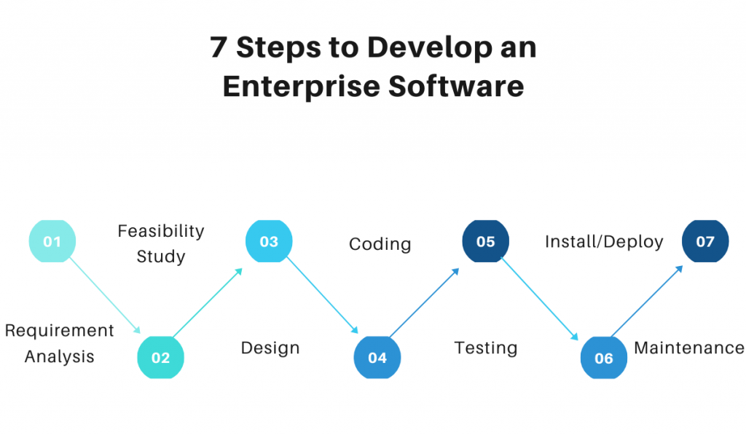
7 Steps to develop enterprise software

Slide 9
How to Develop an Enterprise Application? 5 Steps Guide to Software Development to Success!
It is important to understand that developing an enterprise application is a complex process, and it will take time and effort to create a successful app. But if you follow the 5 steps below, you will have a higher chance of success.
Define the business problem
Conduct research
Create wireframes
Develop prototypes
Test with end-users

Slide 10
Three types of enterprise systems
Now let’s look at the three central systems for businesses that need management software.
Customer relationship management
Enterprise Resource Planning
Supply chain management

Slide 11
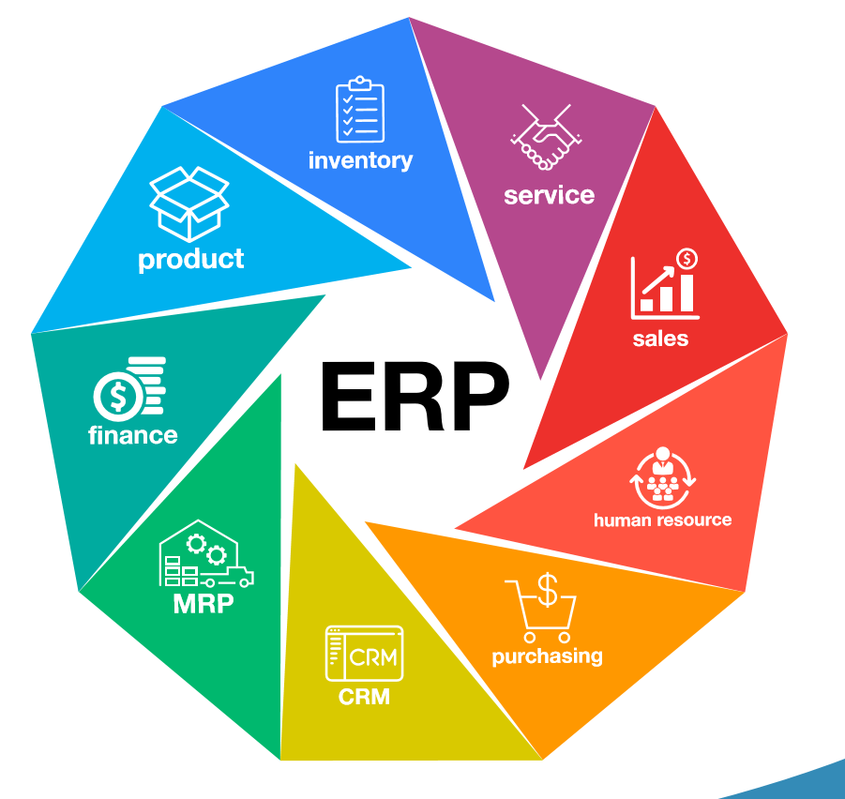
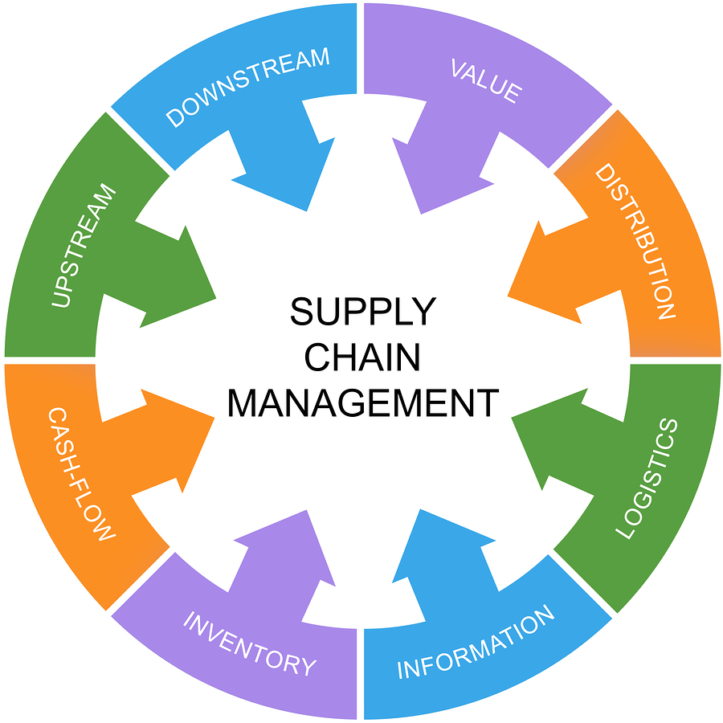
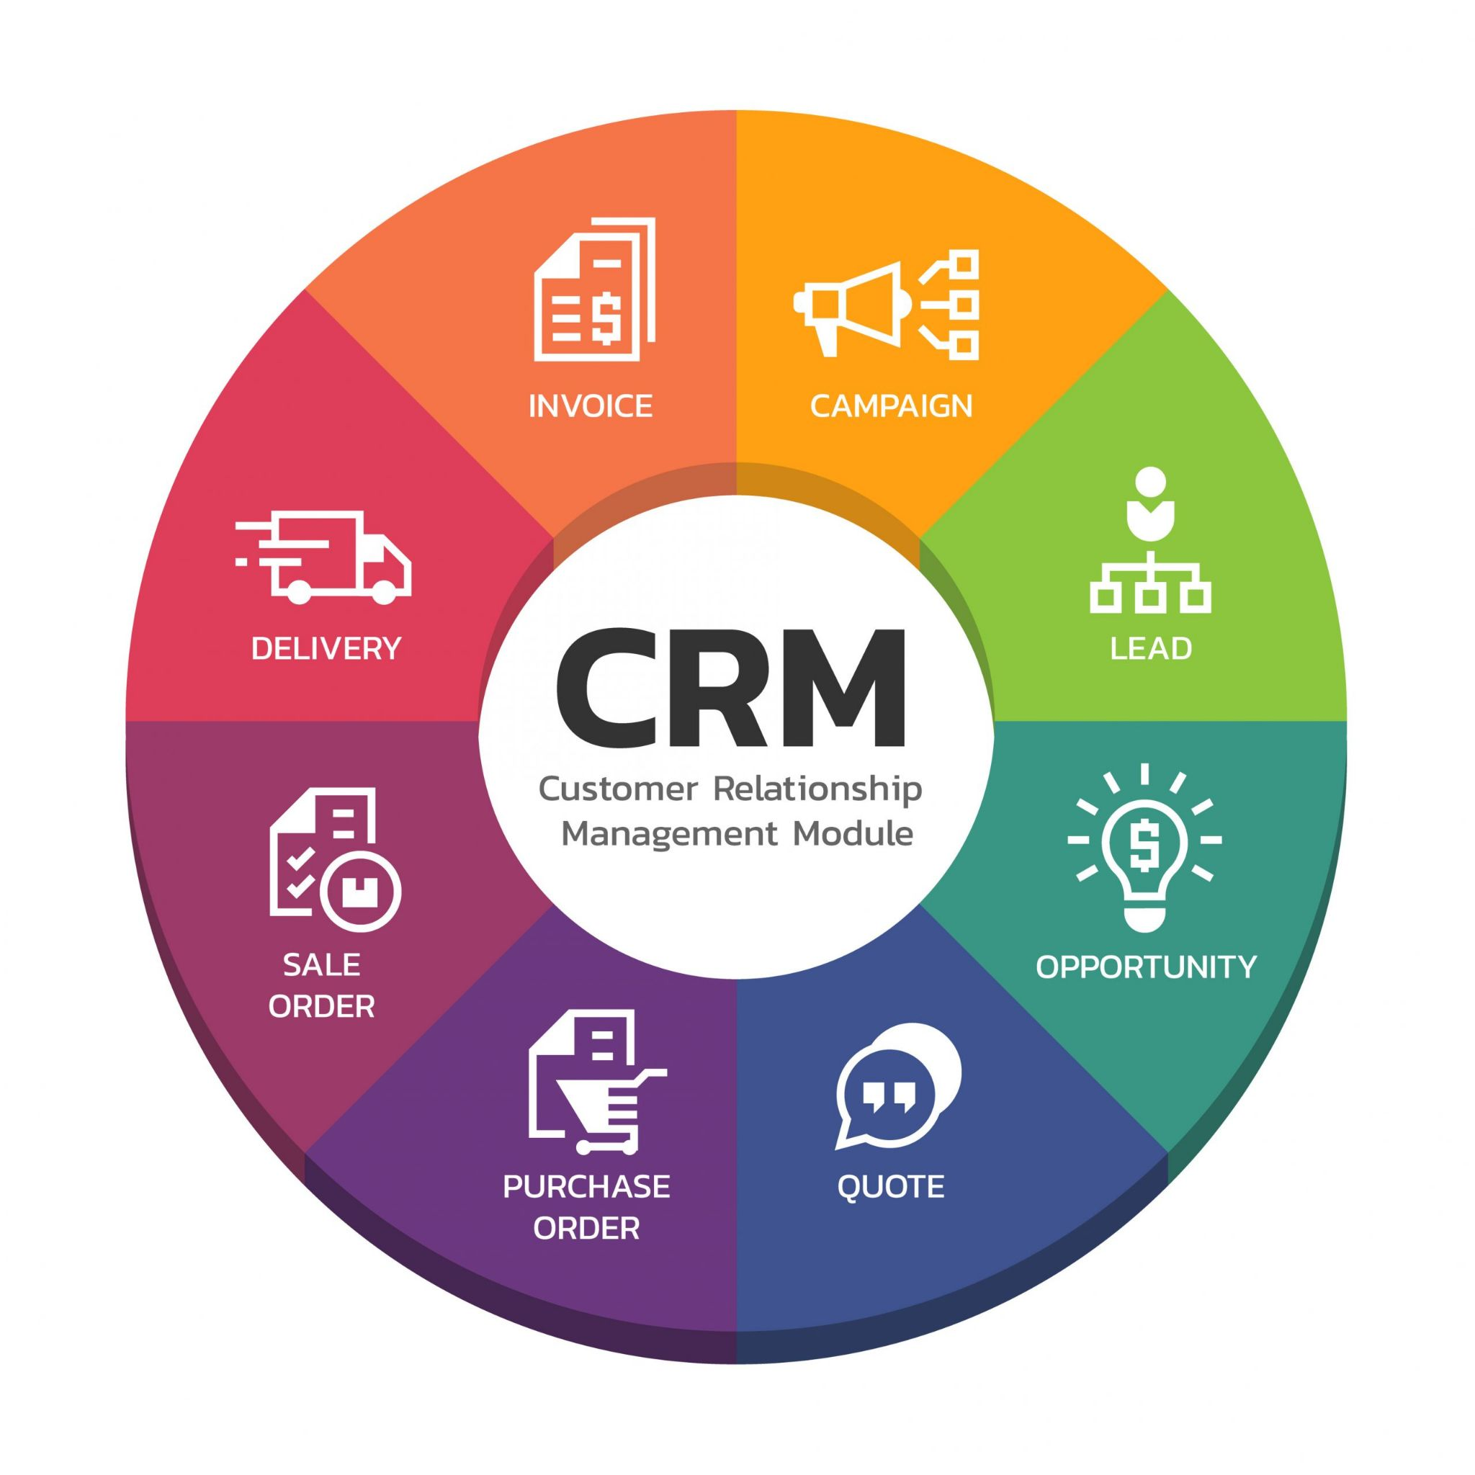

Slide 12
Conclusion
Enterprise software is a technological solution that helps improve the processes and development of a company that already exists.
It is created based on the needs of a company
Enterprise software is an excellent choice for those who want to improve some aspect of the company's productivity, and have already tried everything with human capital.
This type of project has precise controls and particularities that make it distinctive from standard software development.
They are products developed and planned in the long term so that they have a long useful life.
It is a good idea to bet on a contractor or a Technical Co-founder to develop a software of this type since it adds knowledge, experience, and innovation.

Slide 13
Enterprise Software Development Plan
5. Data conversion and uploading Duration: 3-6 weeks. 6. EAS deployment Duration: 1-2 weeks. 7. Regulatory compliance assessment and certification procedures Duration: up to several months. 8. Further EAS evolution in iterations Duration of releases: 1-3-6 months (depending on a development and deployment strategy).
1. Discovery Duration: 1-2 months
2. Enterprise software planning and design Duration: ~ 2 months.
3. UX and UI design Duration: 1 – 3 months. 4. Enterprise Application Software (EAS) development and testing Duration: from ~ 6 months to several years (depending on software complexity).

Slide 14
The difference between enterprise software development and regular software development
Aspects | Enterprise | Regular
Architecture | Multi-faceted and require a more fragmented and extendable structure | Usually focused on one certain goal,
Security | get more attention cybersecurity-wise, getting equipped with multi-layered (sometimes smart) protection mechanisms, user roles for segmented data access | It usually doesn’t go beyond two-factor authentication for the prevention of unauthorized access
Performance | A common requirement for enterprise apps is equally smooth performance across multiple platforms and devices | Most commonly, though, a regular software solution is optimized for the specific operating environment – its target platform
Format | CRM, ERP, PaaS, IaaS, SaaS — apart from traditionally-looking apps, enterprises often require whole specialized systems and platforms for managing various workflows, storing and classifying sensitive information | The general format of a common-purpose software solution may also range widely (from sports and health care to readers, games, social apps, etc.)
Costs | Enterprise software, especially if it is custom, calls for substantial investments to cover a range of services, efforts, and tasks. To this, organizations usually dedicate a separate pool of costs that are calculated based on a number of development team collaboration | Today, you don’t even have to possess a single programmer’s skill in order to build and launch an app of some sort

Slide 15
Case Study
On
ENTERPRISE SOFTWARE DEVELOPMENT SERVICES
Q & A

Slide 16
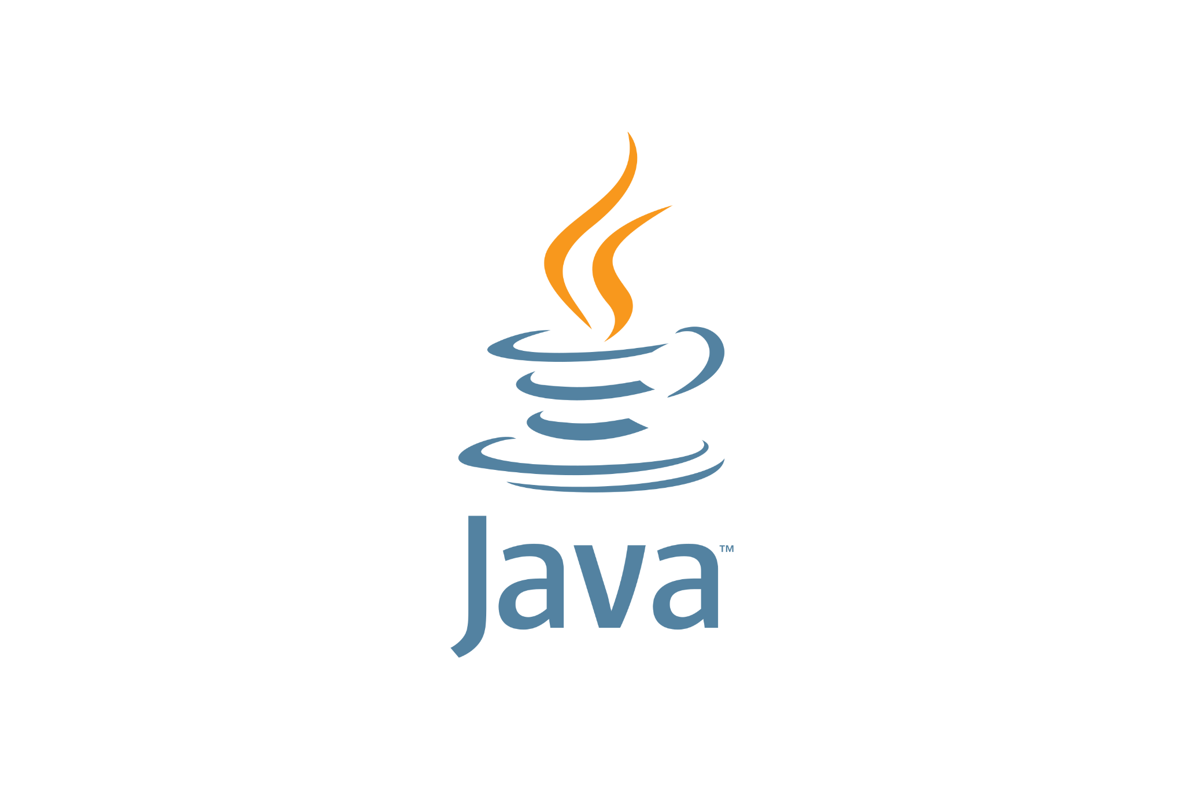
Language: Java

Slide 17
What is Java
Java is a high-level, class-based, object-oriented programming language that is designed to have as few implementation dependencies as possible. It is a general-purpose programming language intended to let programmers write once, run anywhere (WORA)...
Java was originally developed by James Gosling at Sun Microsystems. It was released in May 1995 as a core component of Sun Microsystems' Java platform. The original and reference implementation Java compilers, virtual machines, and class libraries were originally released by Sun under proprietary licenses.

Slide 18
Why Should You Learn Java?
Learning Java has a lot of advantages when compared to other languages. You can perform any task in Java as there are rich libraries and plugins. Java is platform-independent at the source-code and binary levels, which means the code you compile once can be used anywhere. Since Java is object-oriented, the code is split into independent modules, making the code reusable and free from bugs.

Slide 19
System requirements for Java?
Java version(s): 8.0
OS: Ubuntu Linux 14.04 LTS ( and above)
IDE: IntelliJ IDEA
$ java -version
$ sudo apt-get install java -y
$ sudo apt-get install gsfonts libbatik-java -y
* Install IntelliJ using Ubuntu Software Center

Slide 20
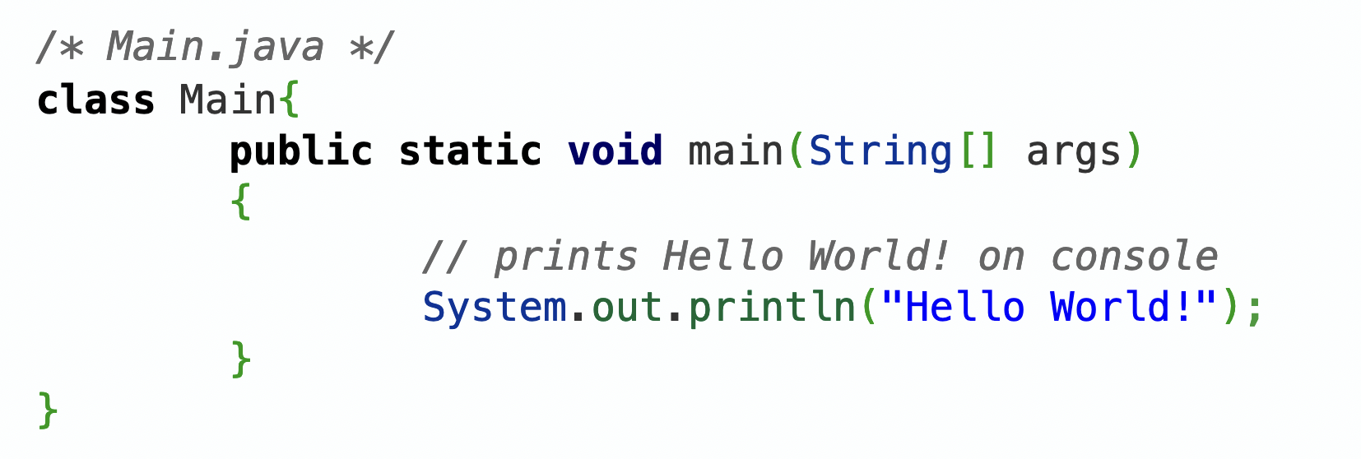
Java Syntax

Slide 21
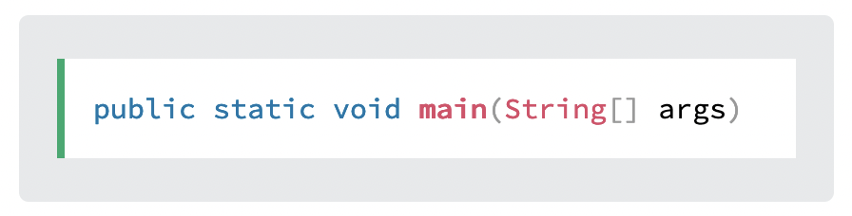
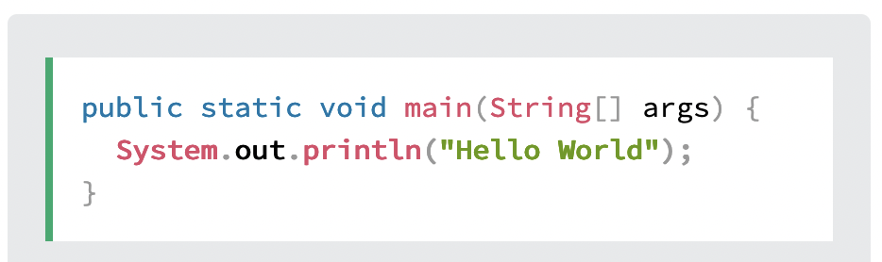
Java Syntax
For now, just remember that every Java program has a class name which must match the filename, and that every program must contain the main() method.
System is a built-in Java class that contains useful members, such as out, which is short for "output". The println() method, short for "print line", is used to print a value to the screen (or a file).
You should also note that each code statement must end with a semicolon (;).

Slide 22
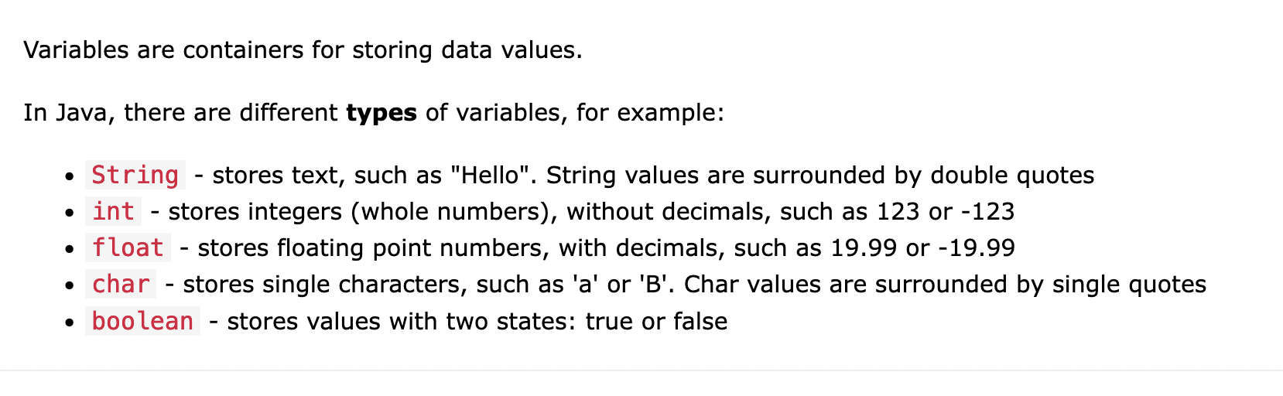
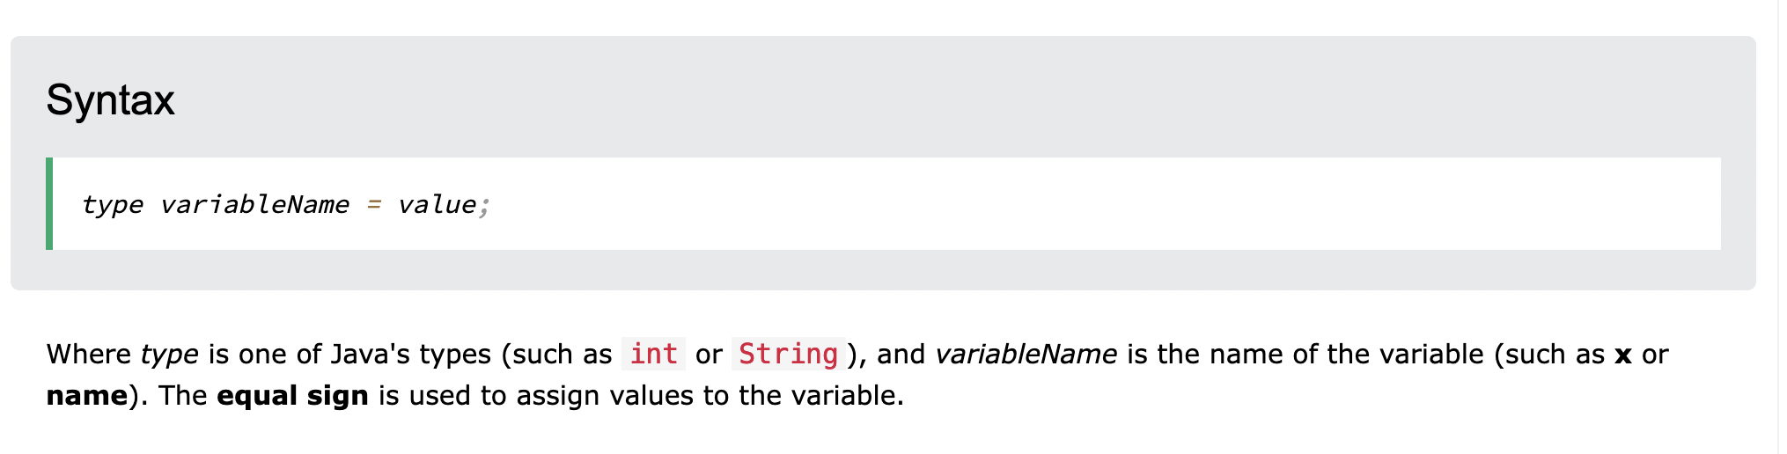
Java Variables

Slide 23
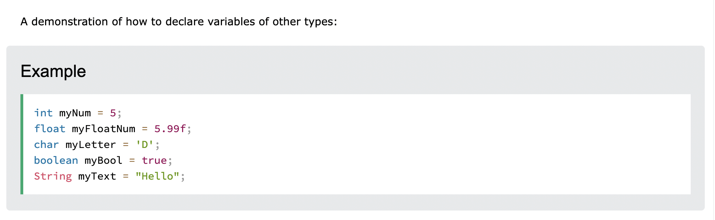
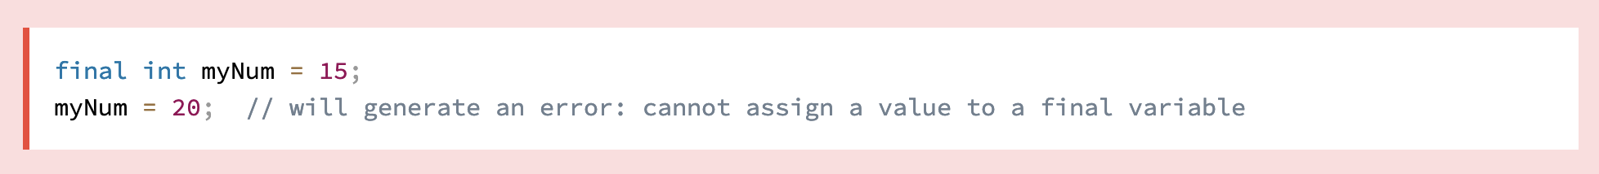
Java Variables
The final keyword (declares the variable as "final" or "constant", which means unchangeable and read-only)

Slide 24
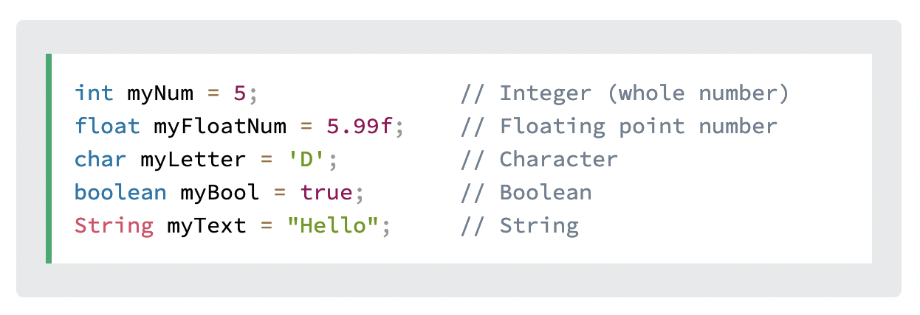
Java Data Types
Data types are divided into two groups:
Primitive data types - includes byte, short, int, long, float, double, boolean and char
Non-primitive data types - such as String, Arrays and Classes

Slide 25
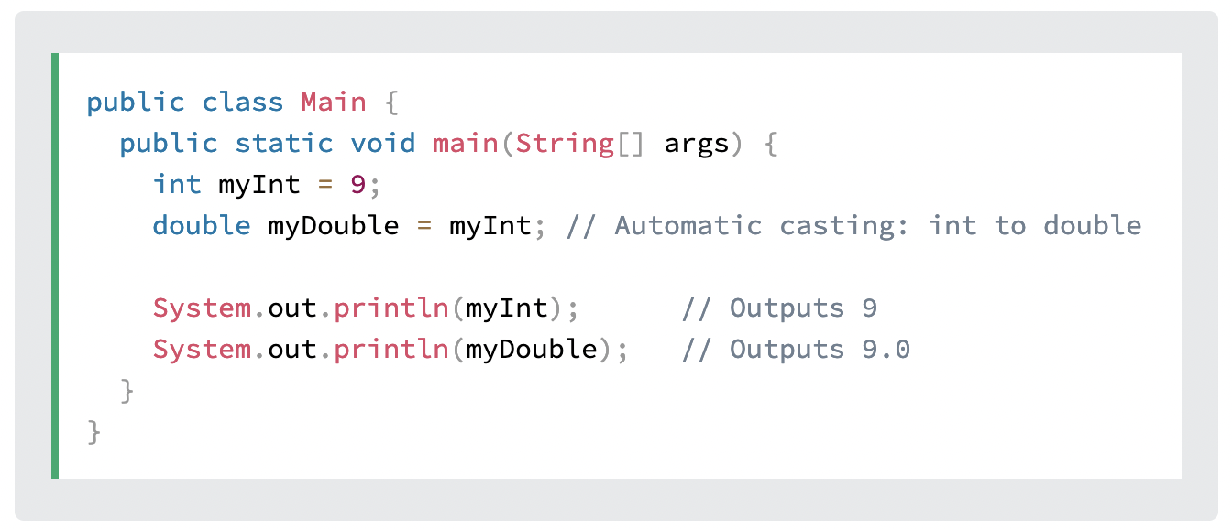
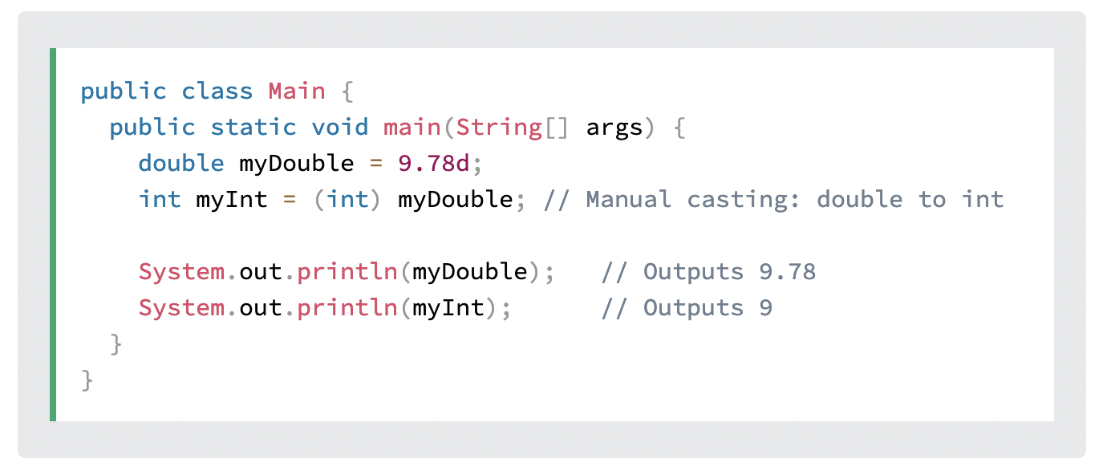
Java Type Casting
Widening
Narrowing
In Java, there are two types of casting:
Widening Casting (automatically) - converting a smaller type to a larger type size byte -> short -> char -> int -> long -> float -> double
Narrowing Casting (manually) - converting a larger type to a smaller size type double -> float -> long -> int -> char -> short -> byte

Slide 26
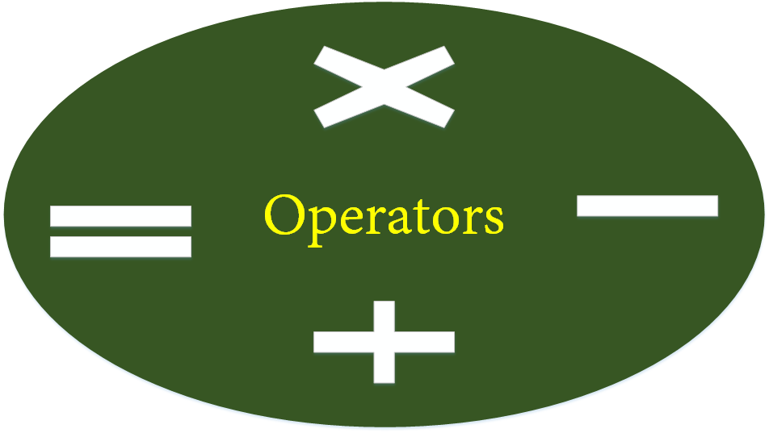
Java Operators
int sum1 = 100 + 50; // 150 (100 + 50)
int sum2 = sum1 + 250; // 400 (150 + 250)
int sum3 = sum2 + sum2; // 800 (400 + 400)
Java divides the operators into the following groups:
Arithmetic operators
Assignment operators
Comparison operators
Logical operators
Bitwise operators

Slide 27
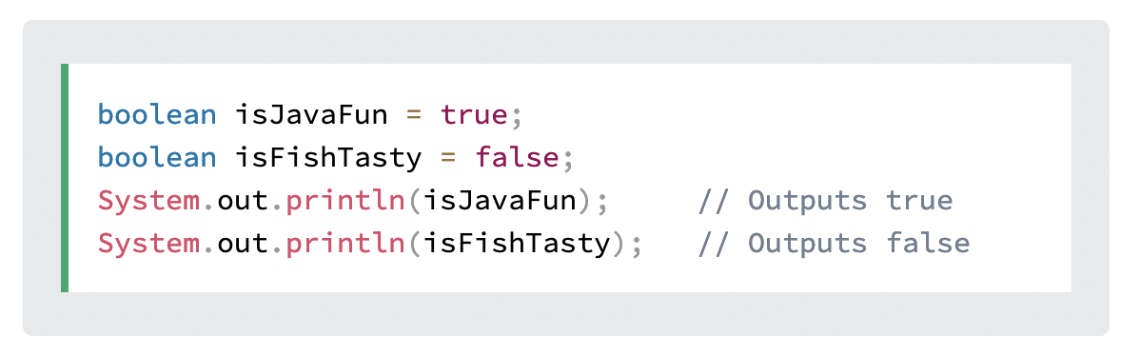
Java Booleans
Very often, in programming, you will need a data type that can only have one of two values, like:
YES / NO
ON / OFF
TRUE / FALSE
For this, Java has a boolean data type, which can store true or false values.

Slide 28
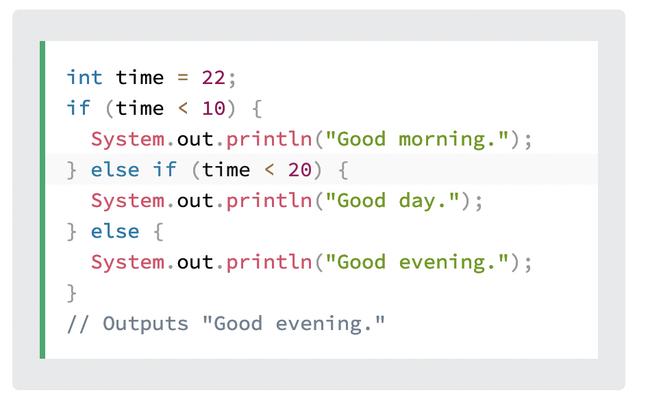
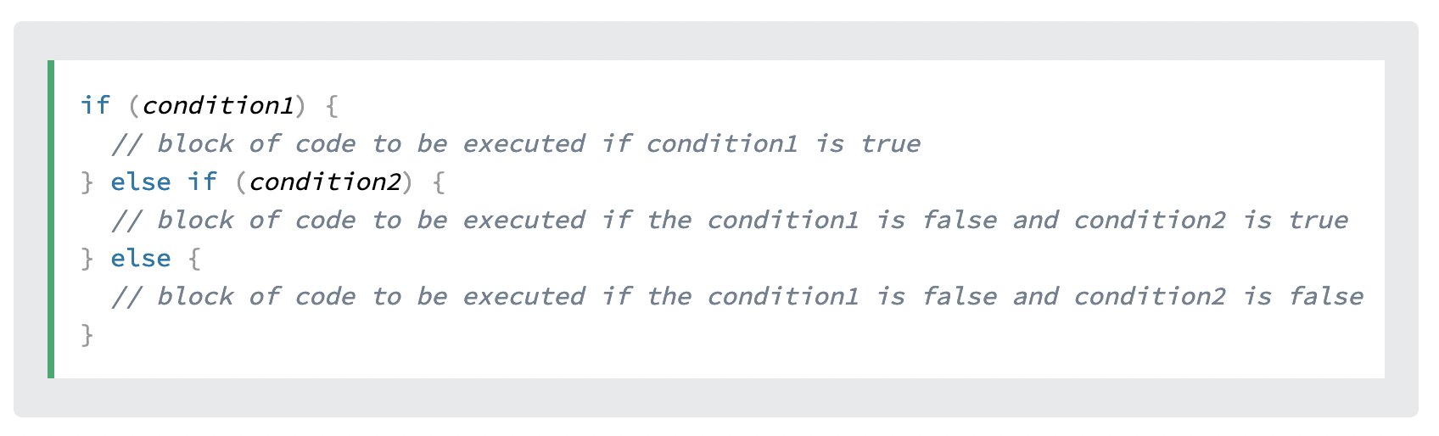
Java If ... Else
Java supports the usual logical conditions from mathematics:
Less than: a < b
Less than or equal to: a <= b
Greater than: a > b
Greater than or equal to: a >= b
Equal to a == b
Not Equal to: a != b

Slide 29
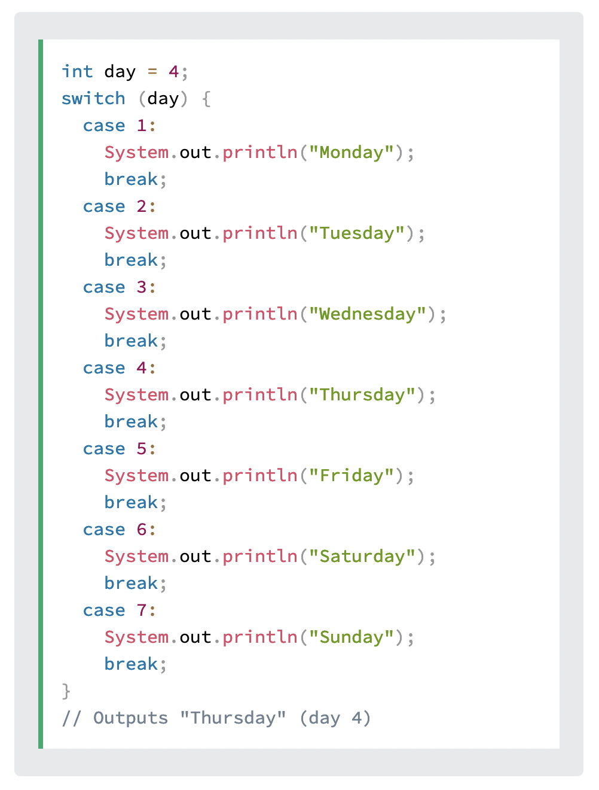
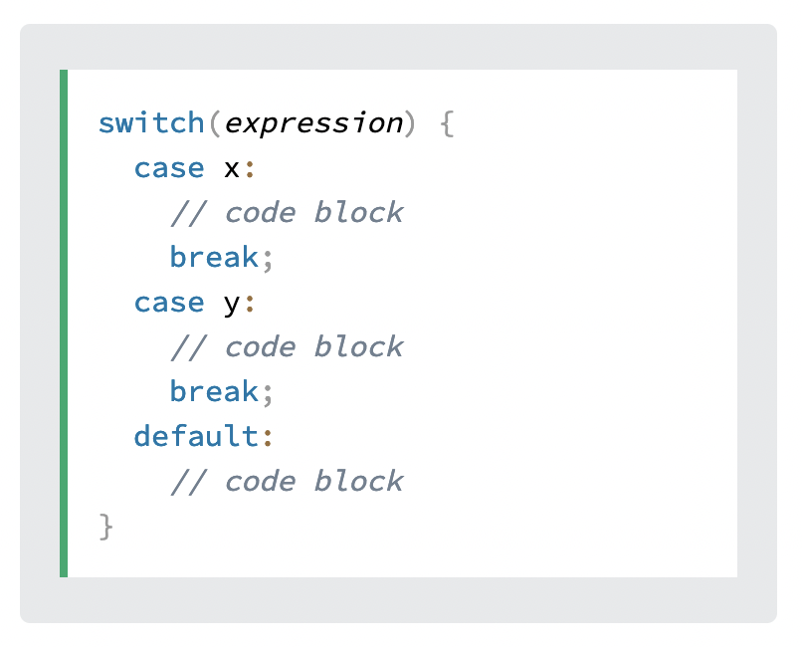
Java Switch

Slide 30
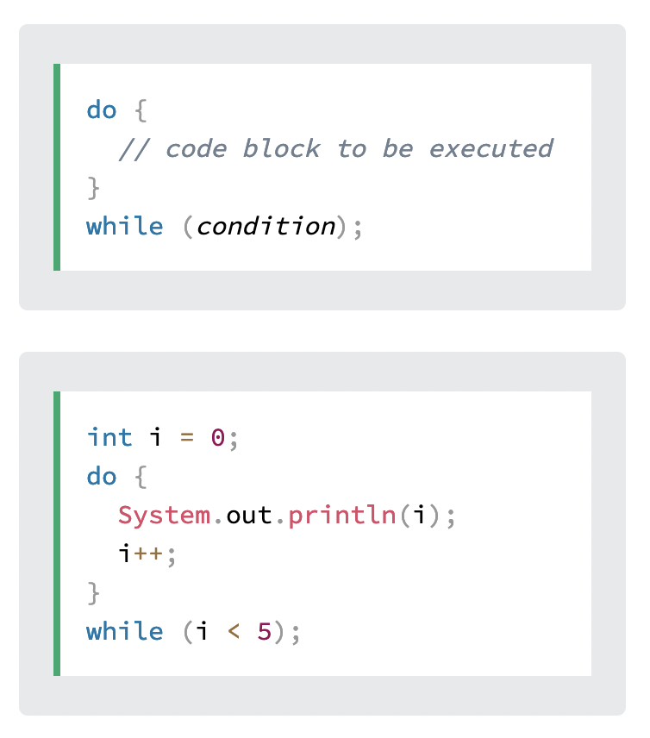
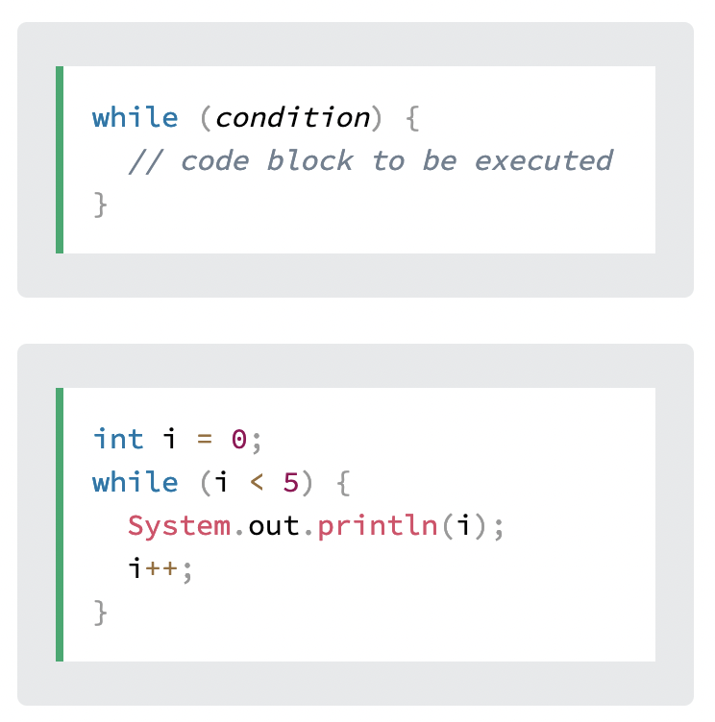
Java While Loop

Slide 31
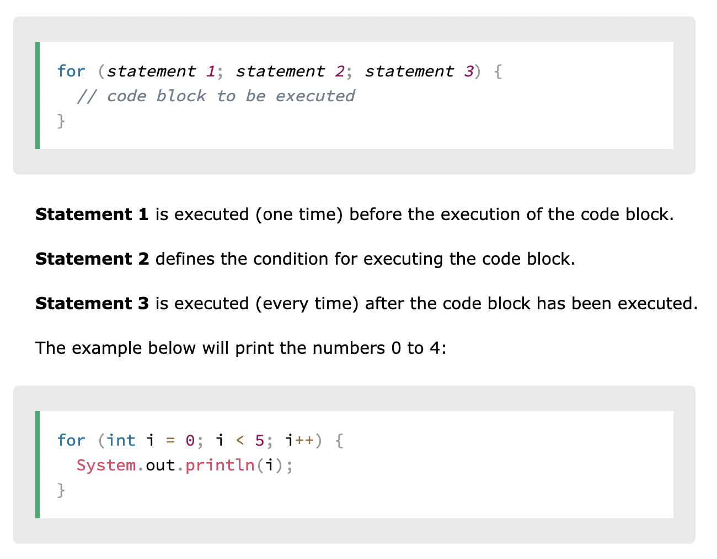
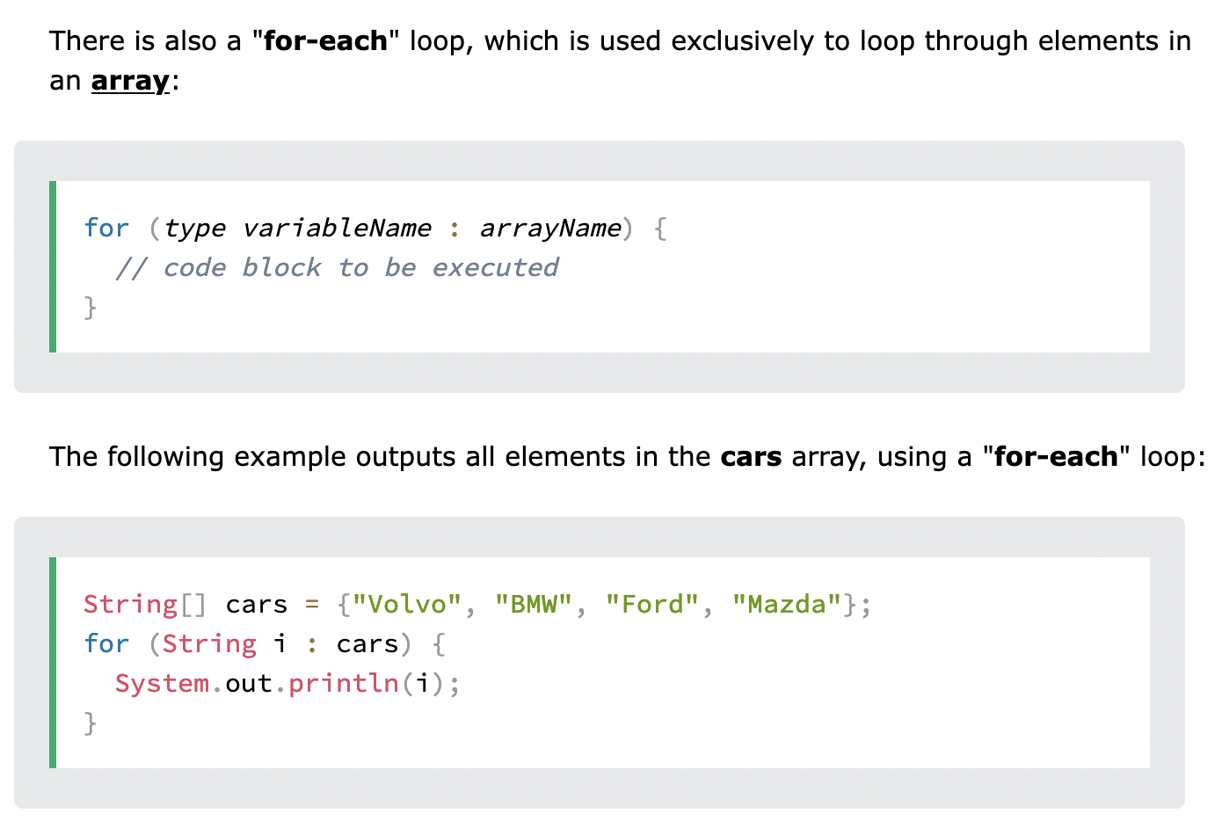
Java For Loop

Slide 32
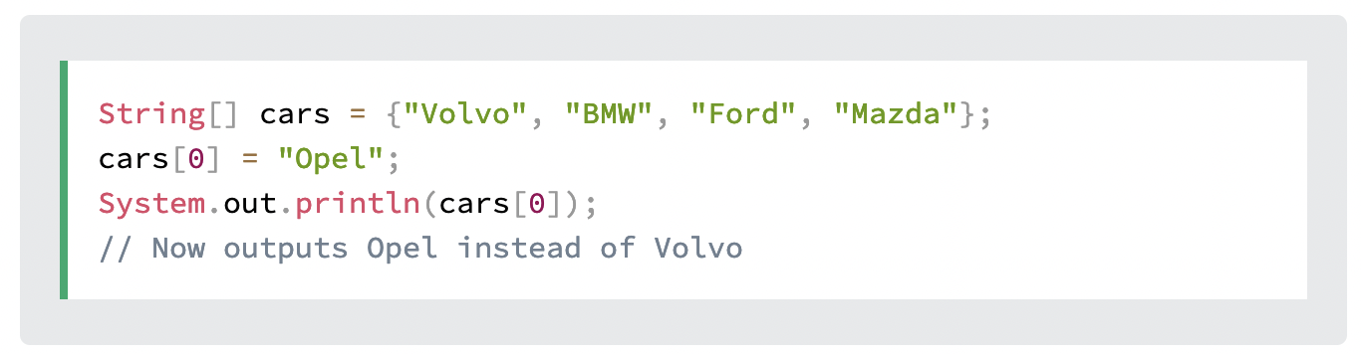
Java Arrays
Arrays are used to store multiple values in a single variable, instead of declaring separate variables for each value.
To declare an array, define the variable type with square brackets:

Slide 33
Java Methods

Slide 34
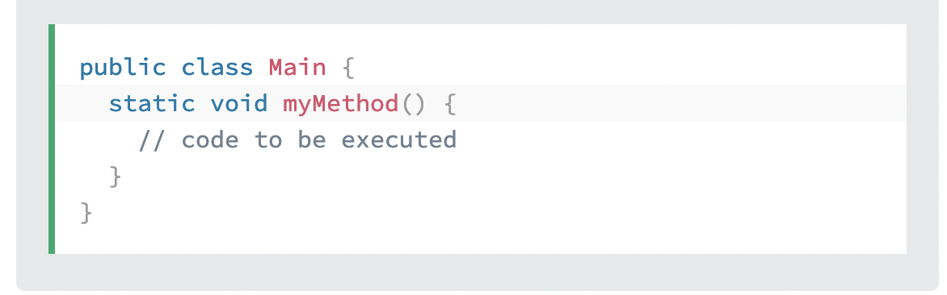
Java Method
A method is a block of code which only runs when it is called.
You can pass data, known as parameters, into a method.
Methods are used to perform certain actions, and they are also known as functions.
Why use methods? To reuse code: define the code once, and use it many times.
myMethod() is the name of the method
static means that the method belongs to the Main class and not an object of the Main class. void means that this method does not have a return value.

Slide 35
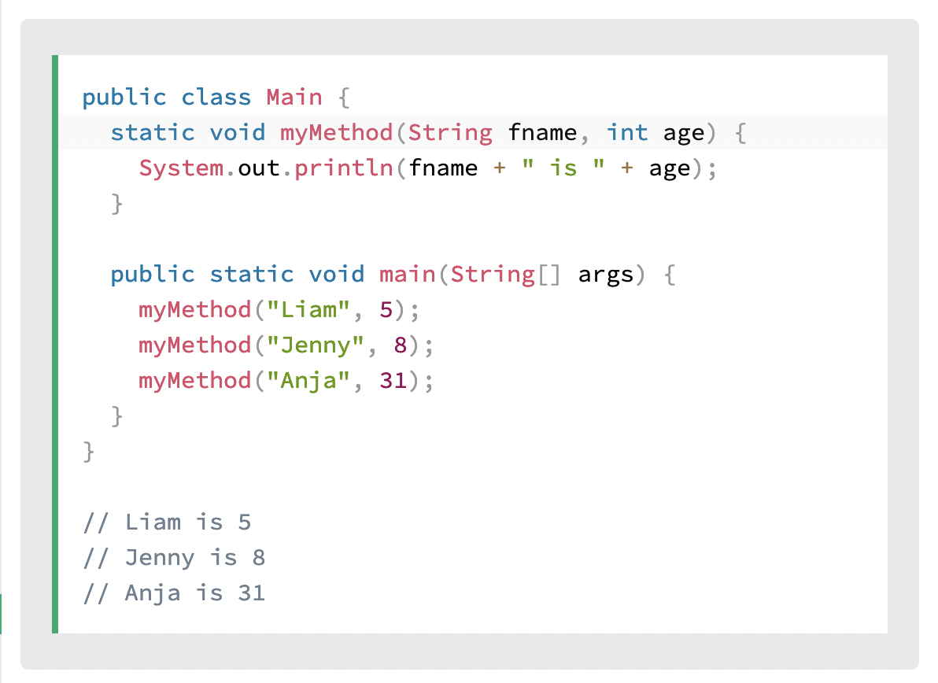
Java Method Parameters
Parameters
You can have as many parameters.

Slide 36
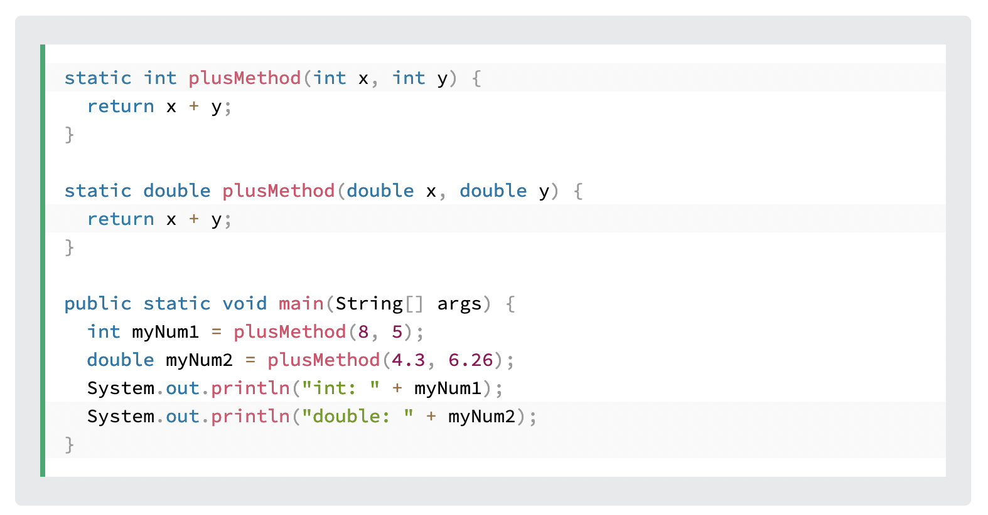
Java Method Overloading
With method overloading, multiple methods can have
the same name with different parameters

Slide 37
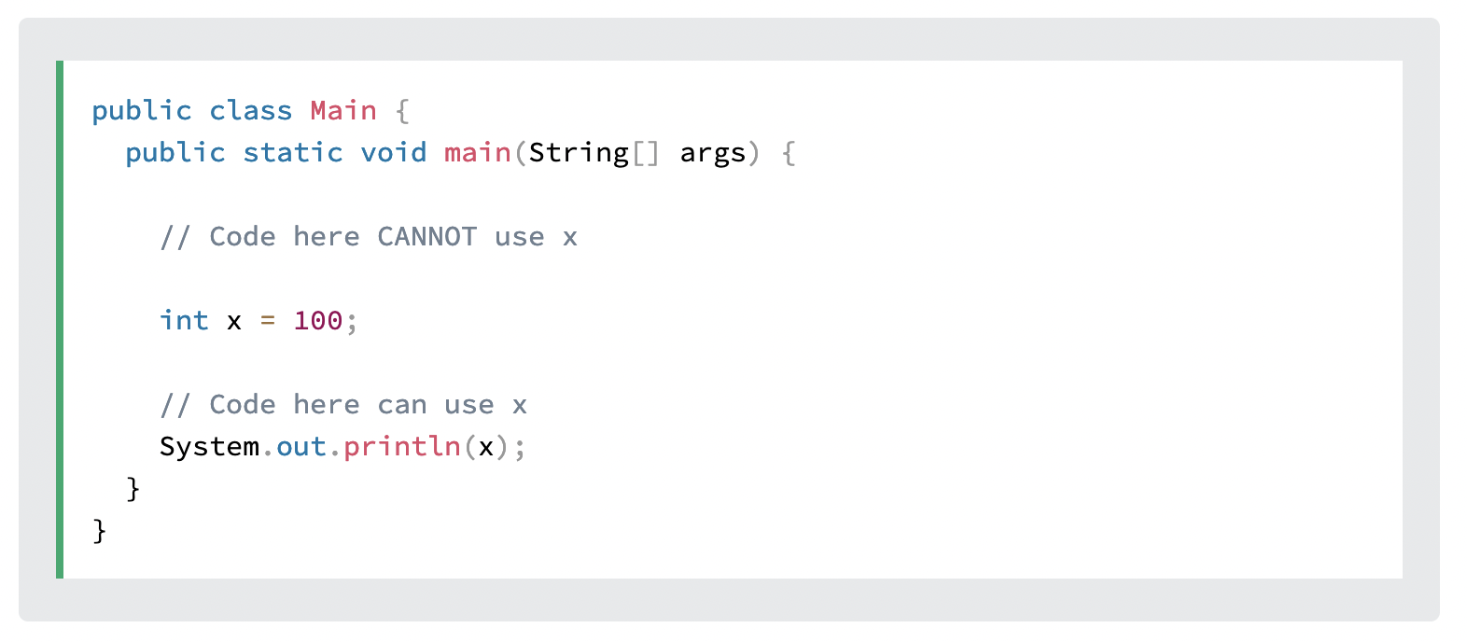
Java Scope
In Java, variables are only accessible inside the region they are created. This is called scope.

Slide 38
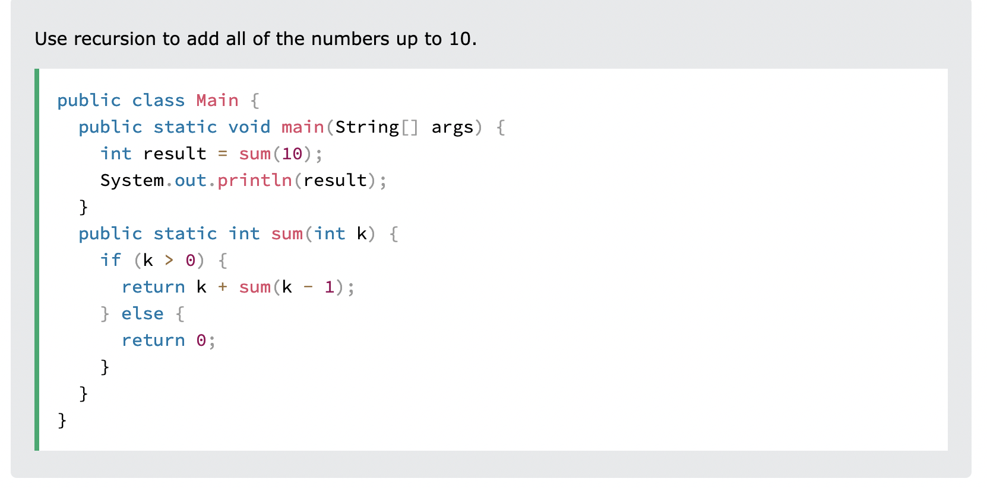
Java Recursion
Recursion is the technique of making a function call itself. This technique provides a way to break complicated problems down into simple problems which are easier to solve.
Recursion may be a bit difficult to understand. The best way to figure out how it works is to experiment with it.

Slide 39
Java Classes

Slide 40
Java OOP
OOP stands for Object-Oriented Programming.
Procedural programming is about writing procedures or methods that perform operations on the data, while object-oriented programming is about creating objects that contain both data and methods.
Object-oriented programming has several advantages over procedural programming:
OOP is faster and easier to execute
OOP provides a clear structure for the programs
OOP helps to keep the Java code DRY "Don't Repeat Yourself", and makes the code easier to maintain, modify and debug
OOP makes it possible to create full reusable applications with less code and shorter development time

Slide 41
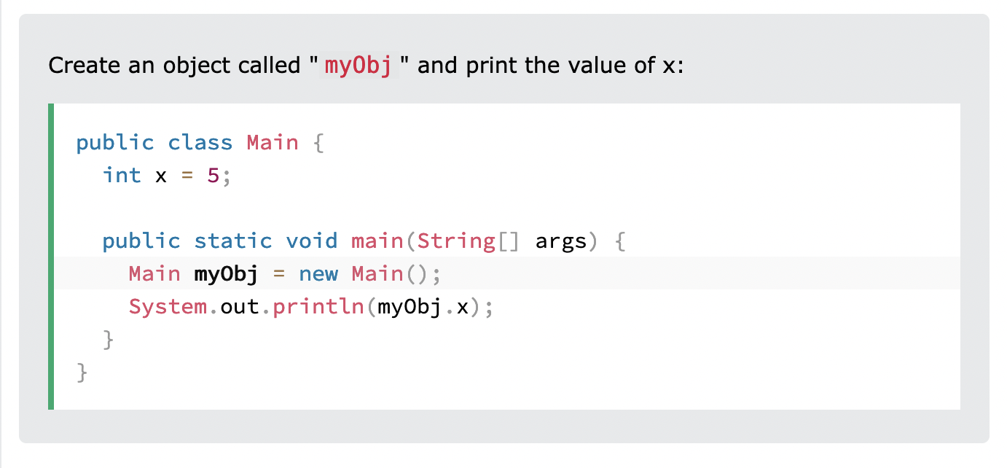
Java Classes/Objects
Java is an object-oriented programming language.
Everything in Java is associated with classes and objects, along with its attributes and methods. For example: in real life, a car is an object. The car has attributes, such as weight and color, and methods, such as drive and brake.
A Class is like an object constructor, or a "blueprint" for creating objects.

Slide 42
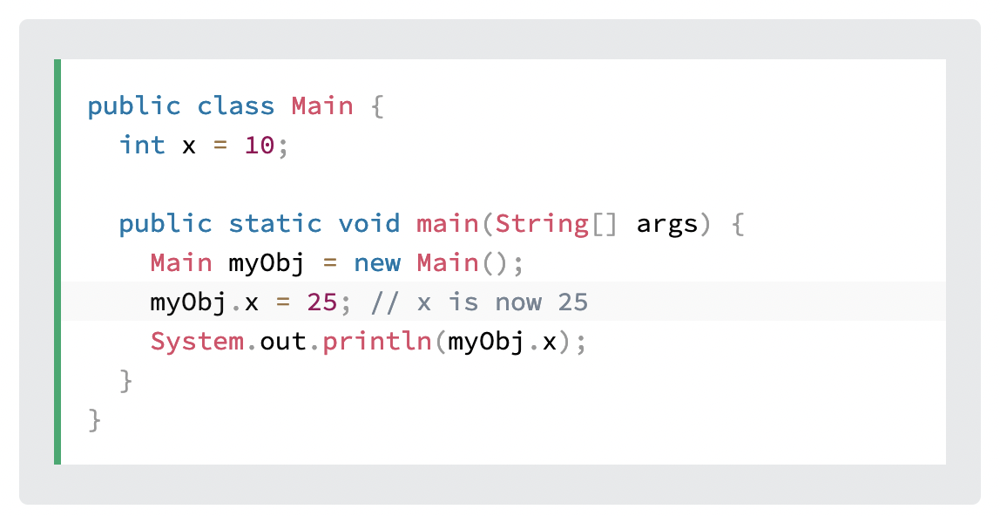
Java Class Attributes
Create a class called "Main" with two attributes: x and y:
QUIZ: Use of final

Slide 43
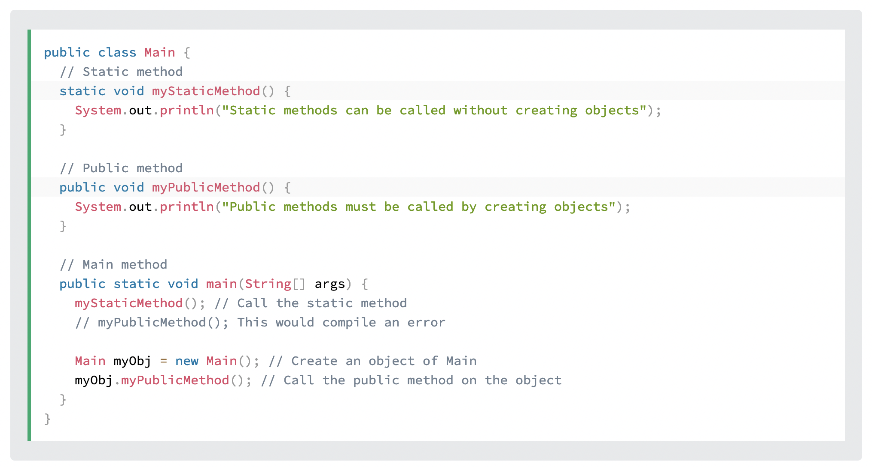
Differences between static and public methods:
The differences between static and public methods.

Slide 44
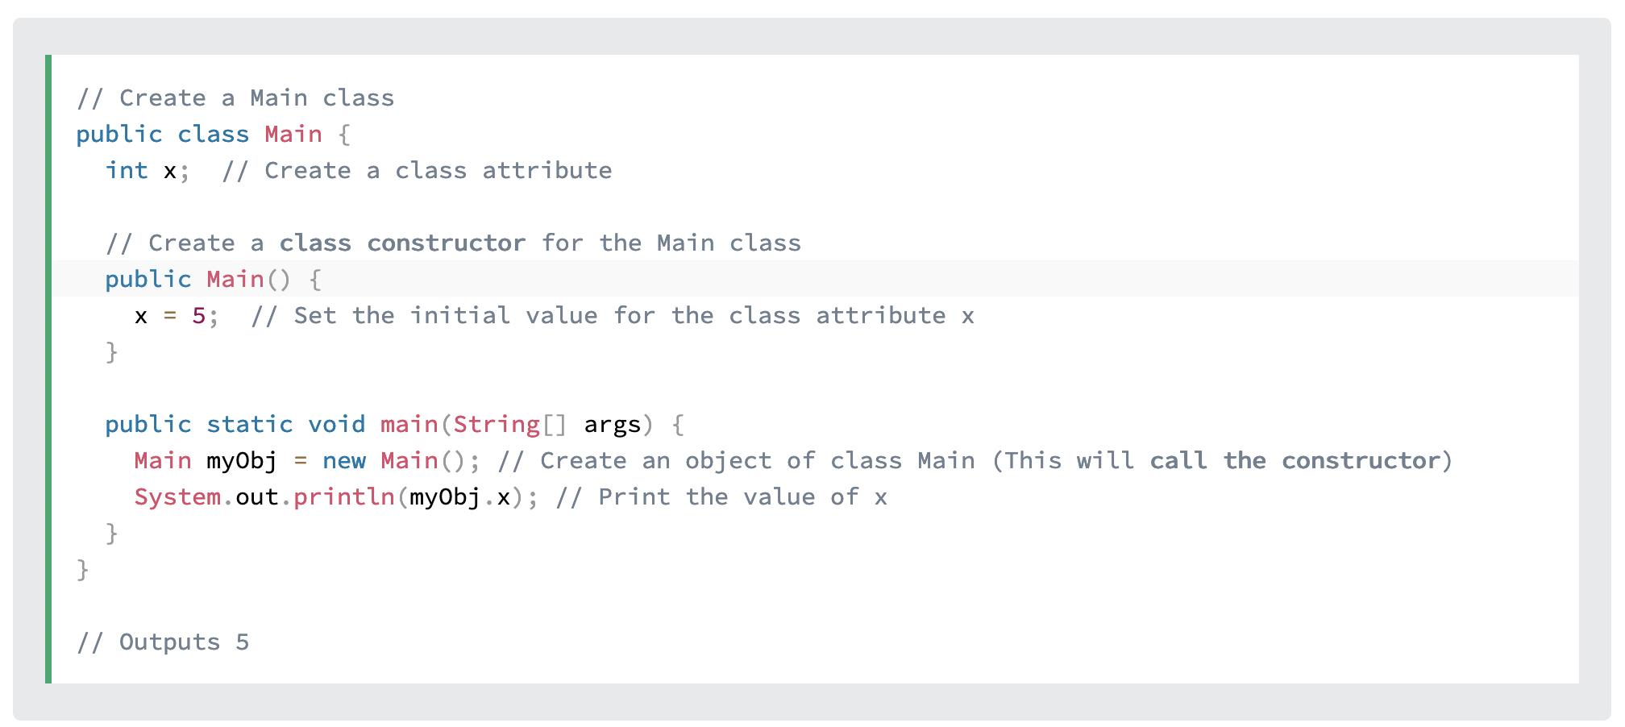
Java Constructors
A constructor in Java is a special method that is used to initialize objects. The constructor is called when an object of a class is created. It can be used to set initial values for object attributes:

Slide 45
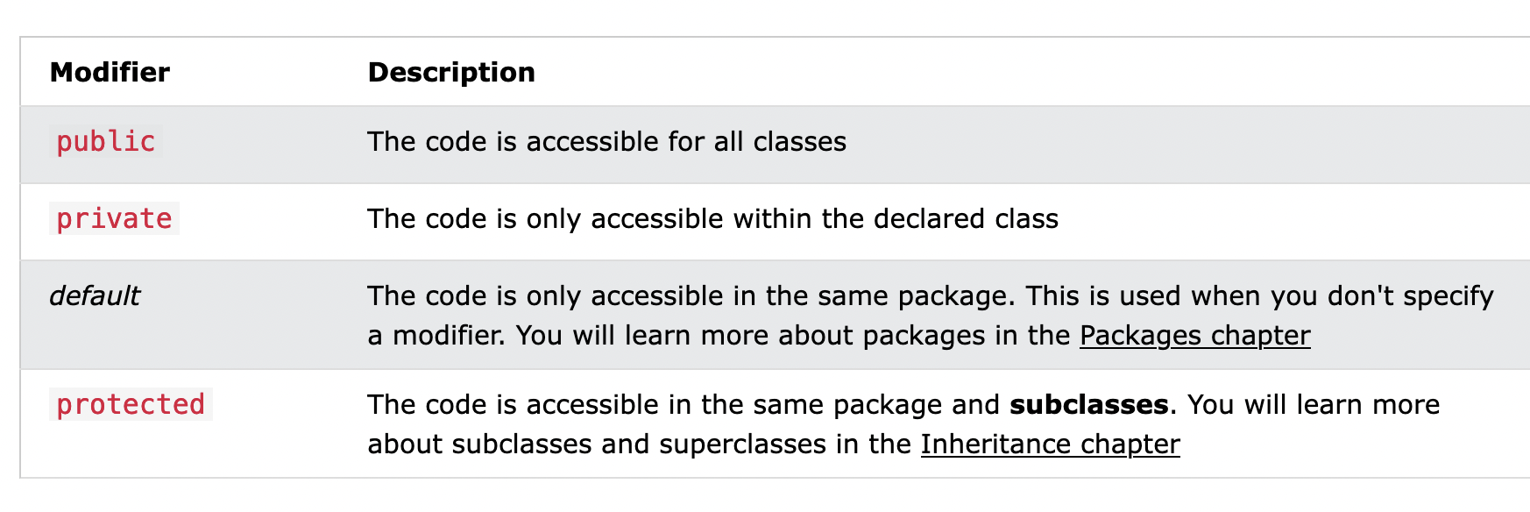
Java Modifiers

Slide 46
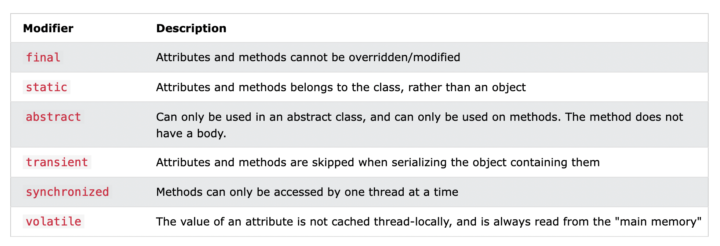
Java Modifiers

Slide 47
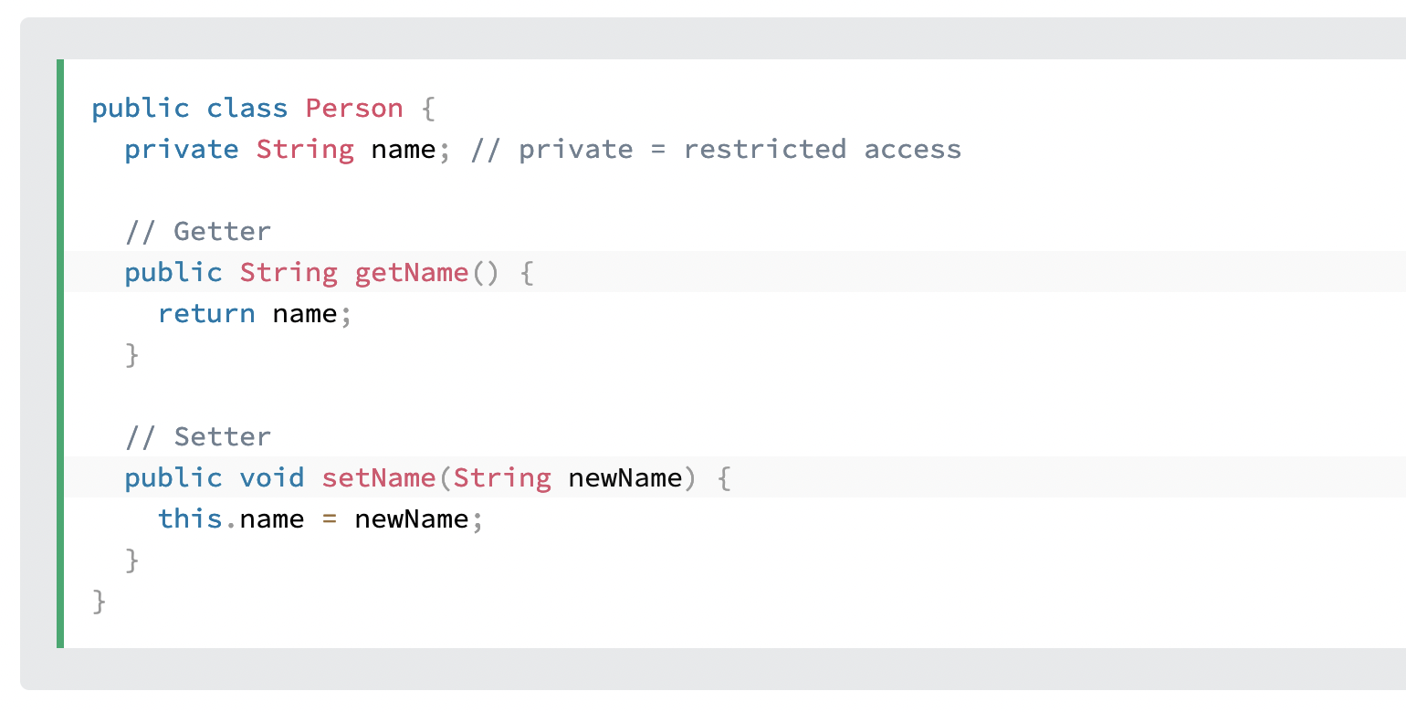
Java Encapsulation
The meaning of Encapsulation, is to make sure that "sensitive" data is hidden from users. To achieve this, you must:
declare class variables/attributes as private
provide public get and set methods to access and update the value of a private variable

Slide 48
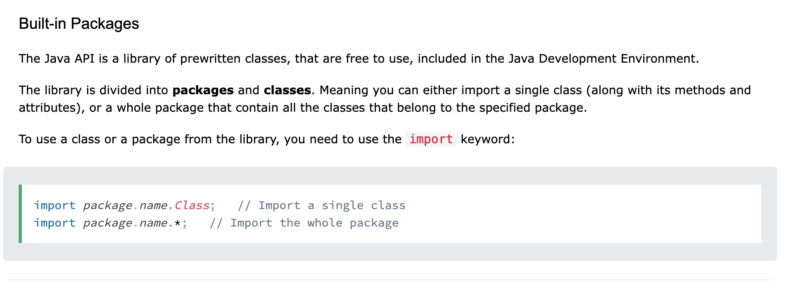
Java Packages & API
A package in Java is used to group related classes. Think of it as a folder in a file directory. We use packages to avoid name conflicts, and to write a better maintainable code. Packages are divided into two categories:
Built-in Packages (packages from the Java API)
User-defined Packages (create your own packages)

Slide 49
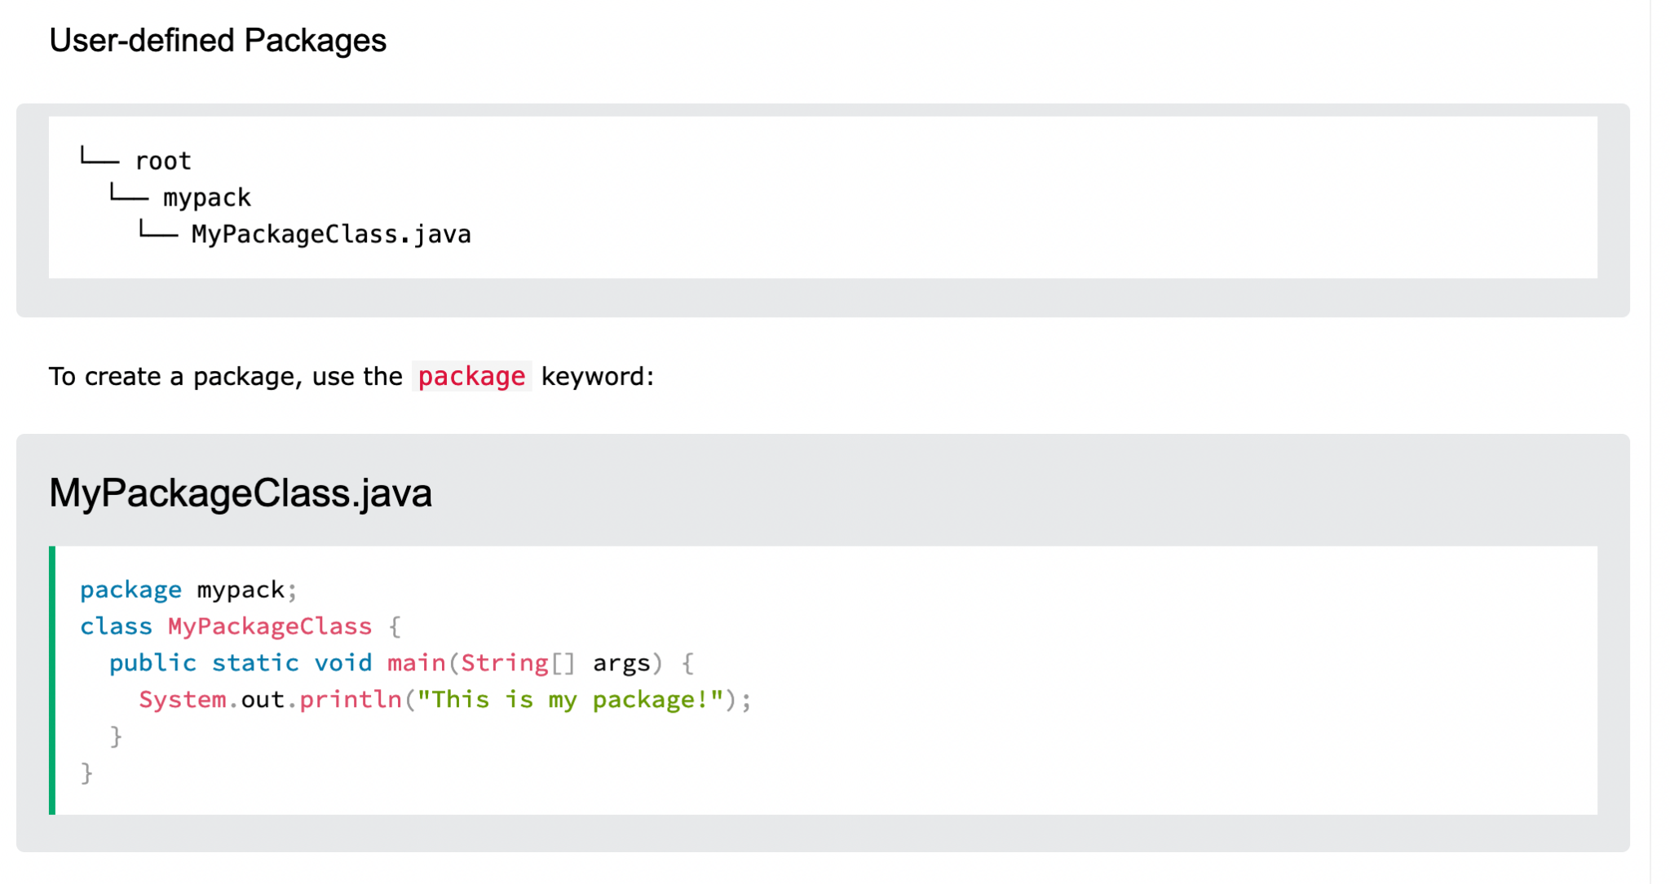
Java Packages & API

Slide 50
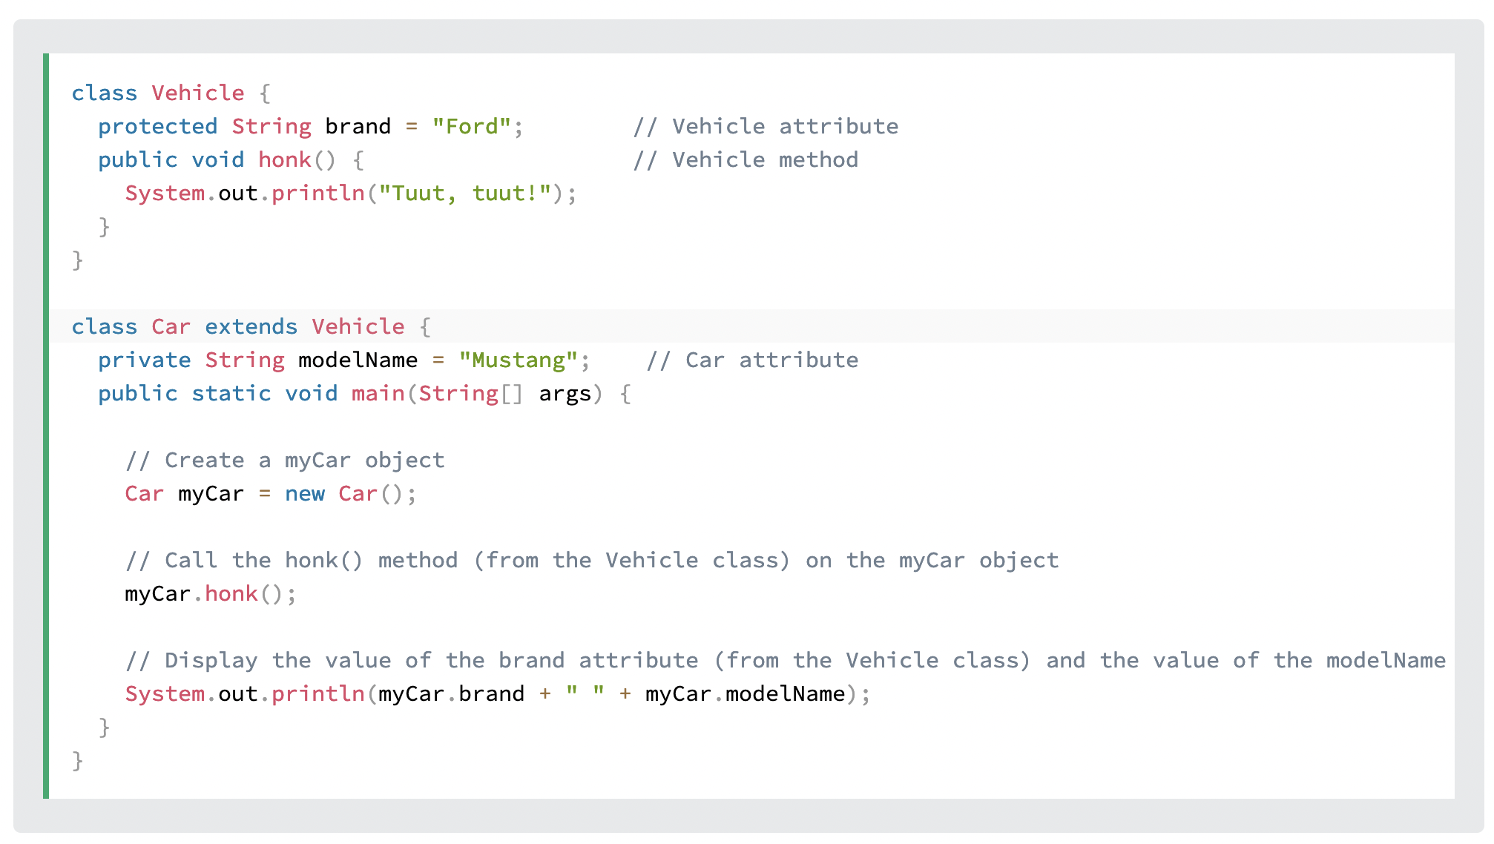
Java Inheritance
In Java, it is possible to inherit attributes and methods from one class to another. We group the "inheritance concept" into two categories:
subclass (child) - the class that inherits from another class
superclass (parent) - the class being inherited from
To inherit from a class, use the extends keyword.

Slide 51
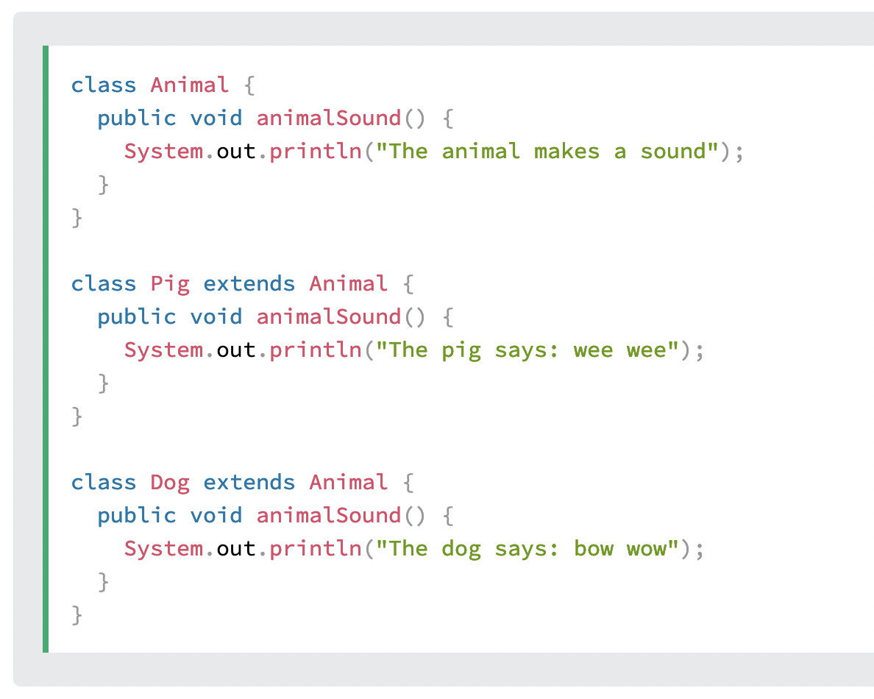
Java Polymorphism
Polymorphism means "many forms", and it occurs when we have many classes that are related to each other by inheritance.
Like we specified in the previous chapter; Inheritance lets us inherit attributes and methods from another class. Polymorphism uses those methods to perform different tasks. This allows us to perform a single action in different ways.
For example, think of a superclass called Animal that has a method called animalSound(). Subclasses of Animals could be Pigs, Cats, Dogs, Birds - And they also have their own implementation of an animal sound (the pig oinks, and the cat meows, etc.):

Slide 52
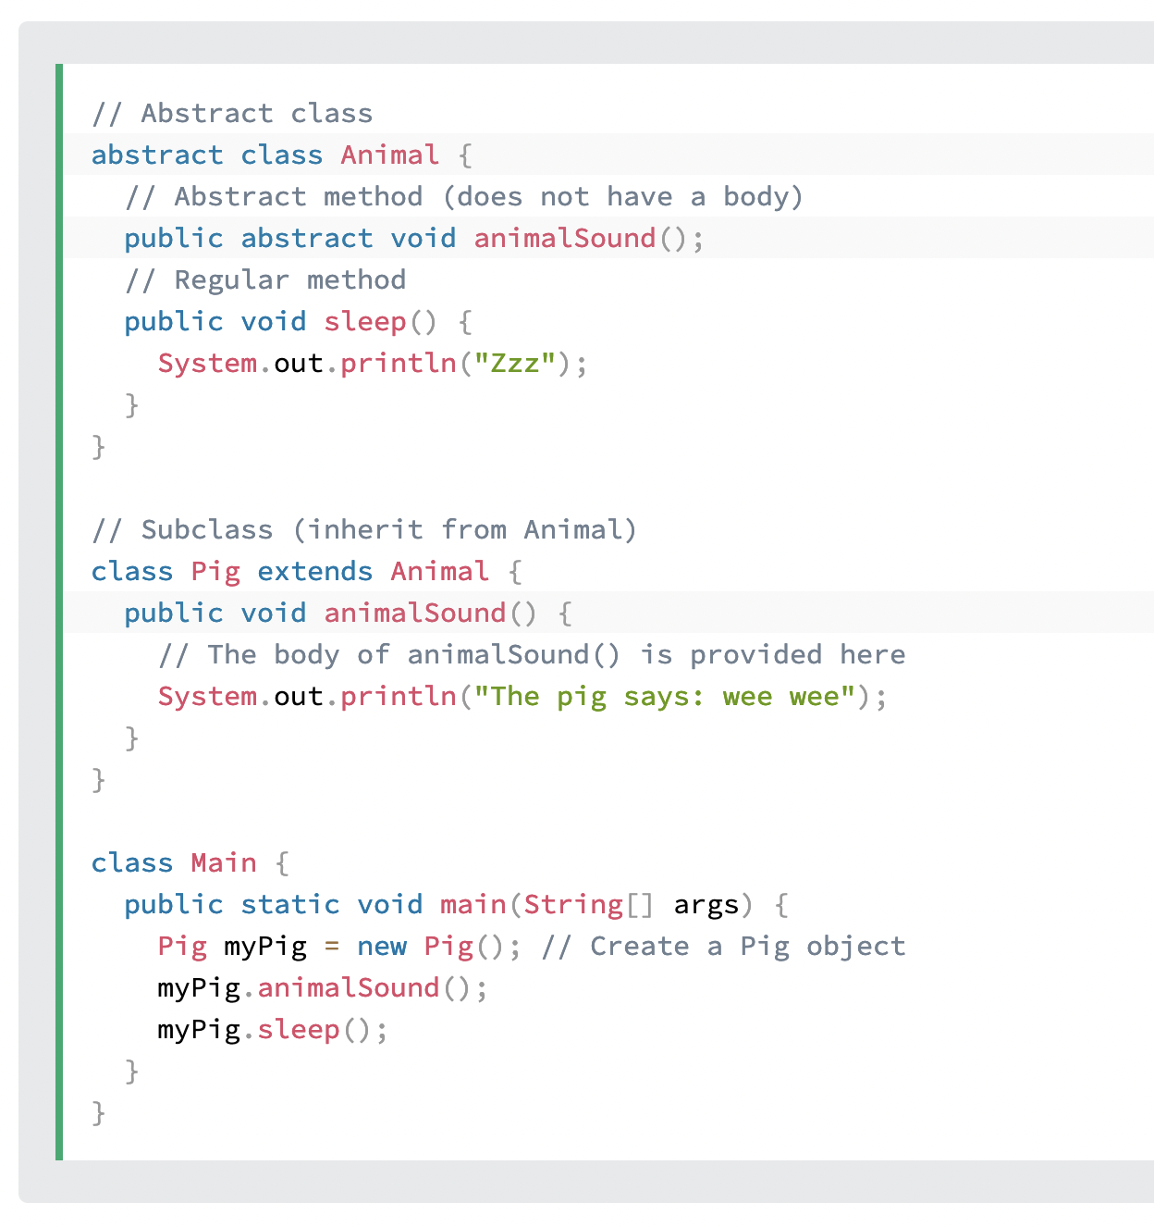
Java Abstraction
Data abstraction is the process of hiding certain details and showing only essential information to the user.
Abstraction can be achieved with either abstract classes or interfaces (which you will learn more about in the next chapter).
The abstract keyword is a non-access modifier, used for classes and methods:
Abstract class: is a restricted class that cannot be used to create objects (to access it, it must be inherited from another class).
Abstract method: can only be used in an abstract class, and it does not have a body. The body is provided by the subclass (inherited from).

Slide 53
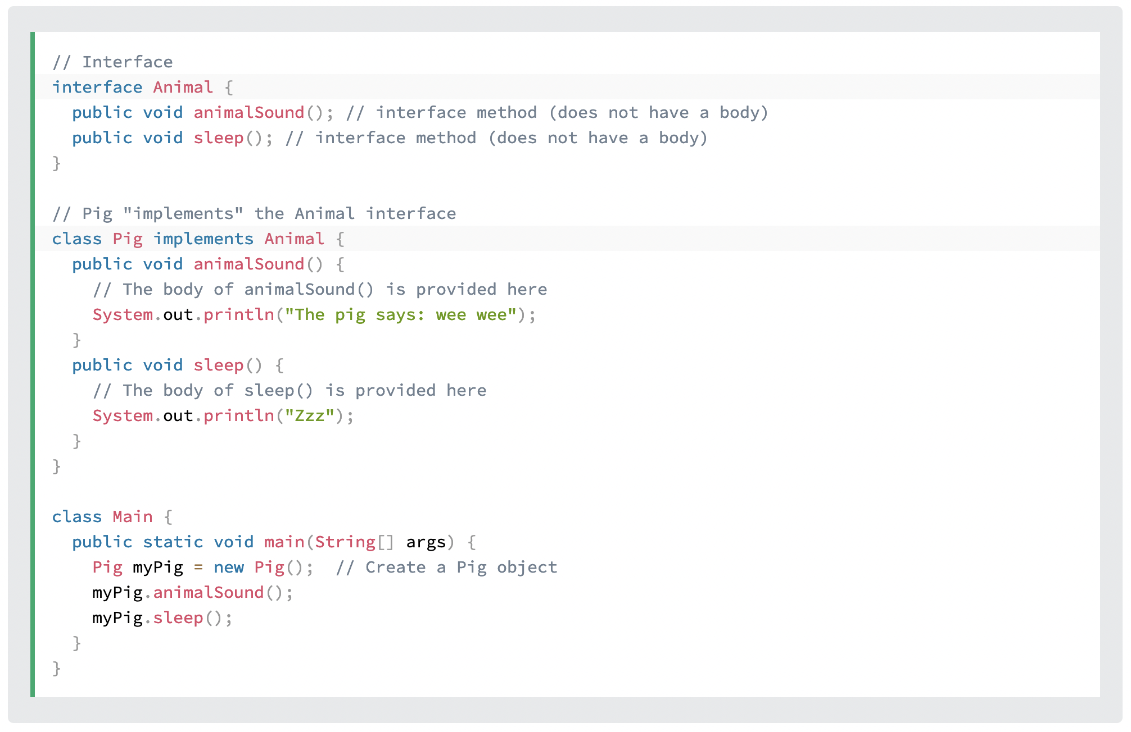
Java Interface
Another way to achieve abstraction in Java, is with interfaces.
An interface is a completely "abstract class" that is used to group related methods with empty bodies

Slide 54
Quiz on Enums & Usage

Slide 55
=== LAB ===
Java User Input
Java Date and Time
Java ArrayList
Java HashMap
Java Iterator

Slide 56
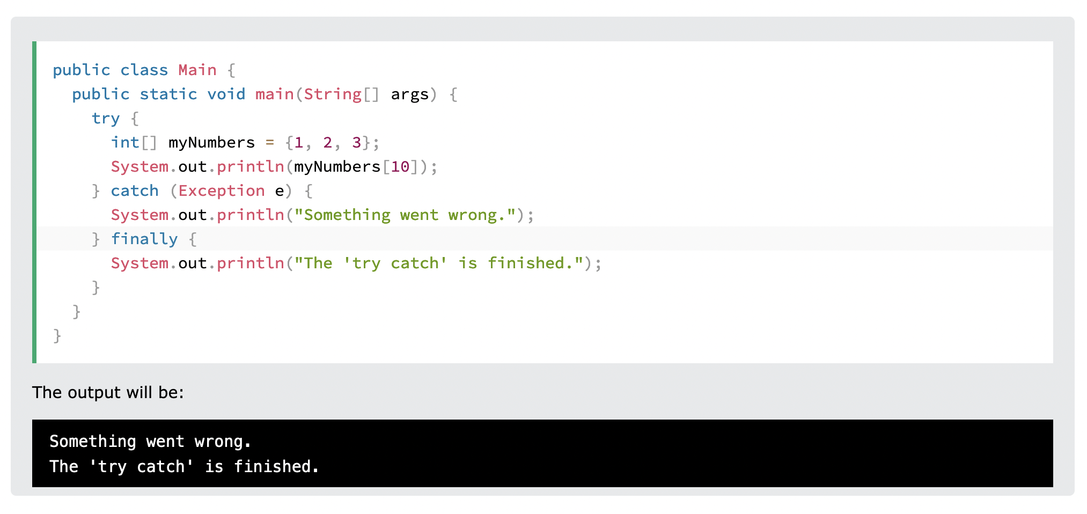
Java Exceptions - Try...Catch
The try statement allows you to define a block of code to be tested for errors while it is being executed.
The catch statement allows you to define a block of code to be executed, if an error occurs in the try block.
The try and catch keywords come in pairs

Slide 57
Java Threads
Threads allows a program to operate more efficiently by doing multiple things at the same time.
Threads can be used to perform complicated tasks in the background without interrupting the main program.

Slide 58
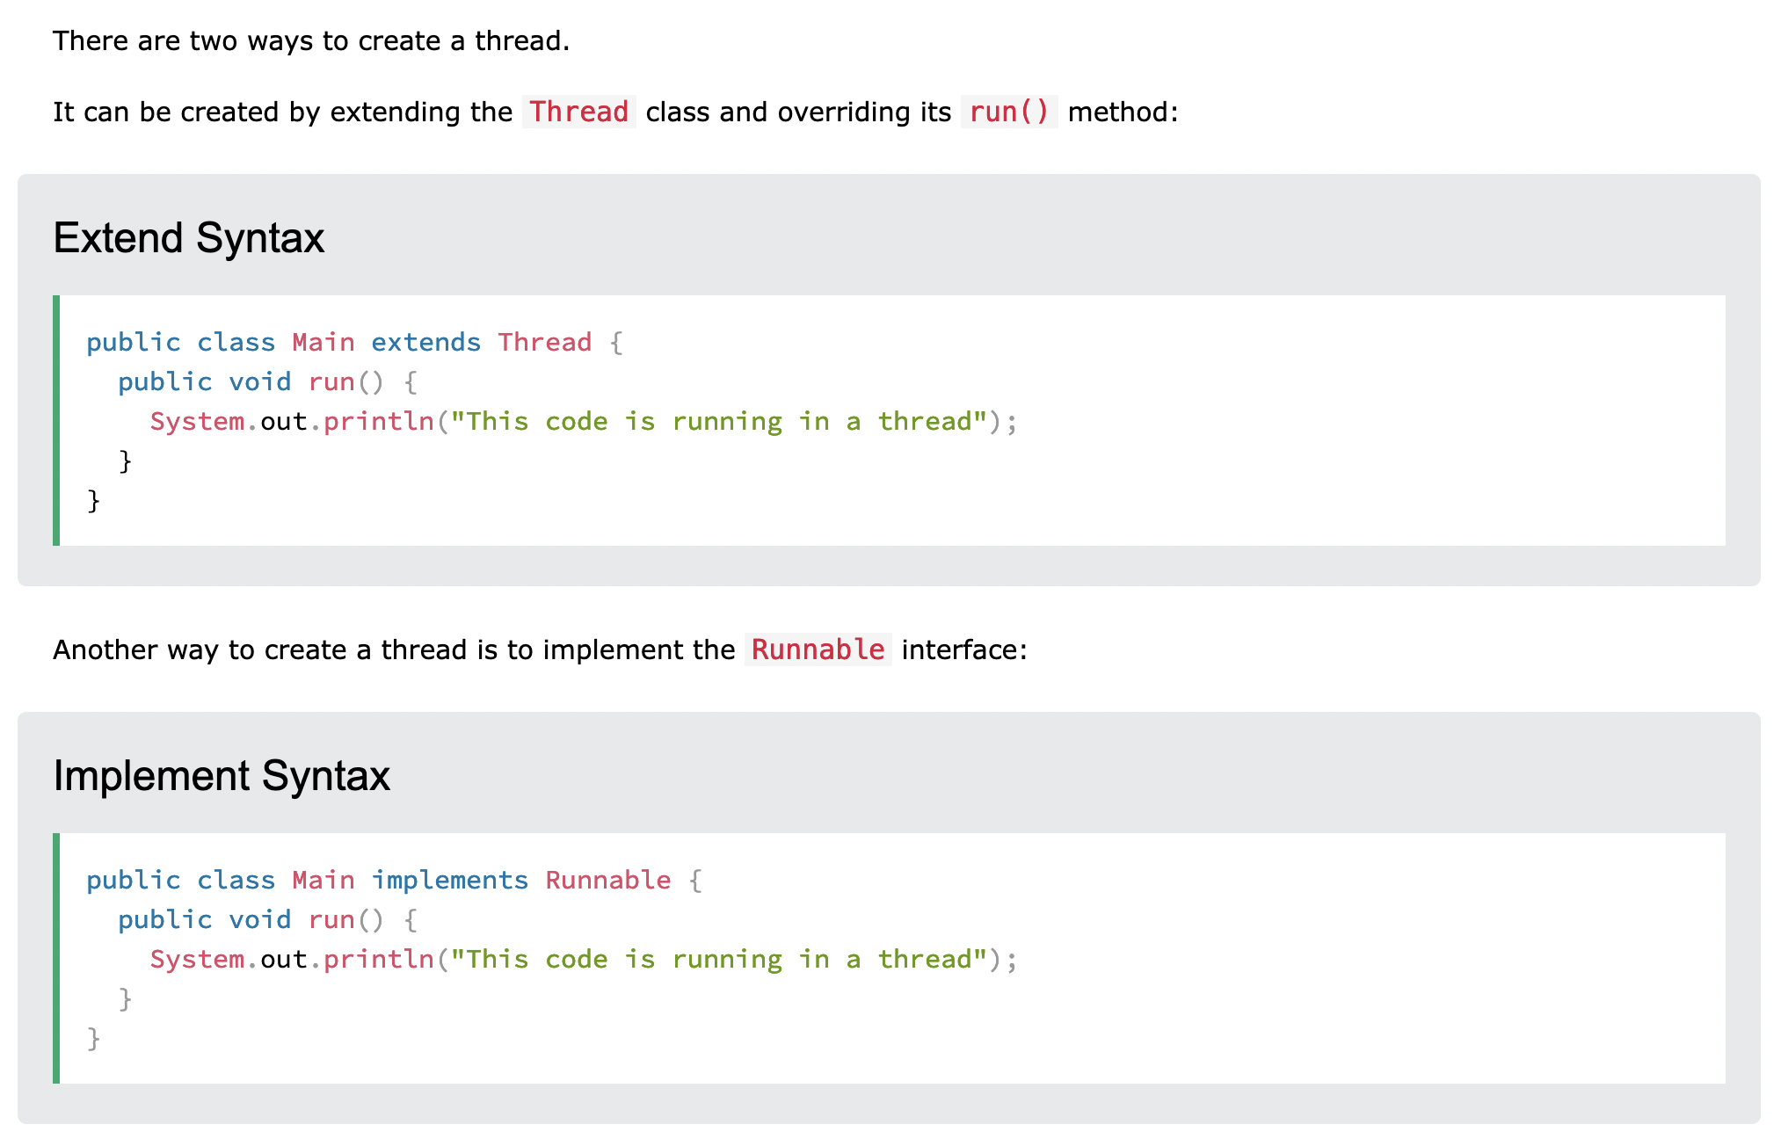
Java Threads

Slide 59
Exercise
https://www.w3schools.com/java/exercise.asp

Slide 60

Sprint Boot

Slide 61
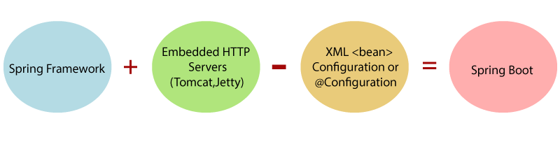
What is Spring Boot
Spring Boot is a project that is built on the top of the Spring Framework. It provides an easier and faster way to set up, configure, and run both simple and web-based applications.
It is a Spring module that provides the RAD (Rapid Application Development) feature to the Spring Framework. It is used to create a stand-alone Spring-based application that you can just run because it needs minimal Spring configuration.

Slide 62
Why should we use Spring Boot Framework?
We should use Spring Boot Framework because:
The dependency injection approach is used in Spring Boot.
It contains powerful database transaction management capabilities.
It simplifies integration with other Java frameworks like JPA/Hibernate ORM, Struts, etc.
It reduces the cost and development time of the application.

Slide 63
Why should we use Spring Boot Framework?
We should use Spring Boot Framework because:
The dependency injection approach is used in Spring Boot.
It contains powerful database transaction management capabilities.
It simplifies integration with other Java frameworks like JPA/Hibernate ORM, Struts, etc.
It reduces the cost and development time of the application.

Slide 64
Limitations of Spring Boot
Why Spring Boot?
Spring Boot can use dependencies that are not going to be used in the application. These dependencies increase the size of the application.
You can choose Spring Boot because of the features and benefits it offers as given here
It provides a flexible way to configure Java Beans, XML configurations, and Database Transactions.
It provides a powerful batch processing and manages REST endpoints.
In Spring Boot, everything is auto configured; no manual configurations are needed.
It offers annotation-based spring application
Eases dependency management
It includes Embedded Servlet Container

Slide 65
Prerequisite of Spring Boot
Java 1.8
Maven 3.0+
Spring Framework 5.0.0.BUILD-SNAPSHOT
An IDE (Spring Tool Suite) is recommended.

Slide 66
Spring Boot Features
Web Development
SpringApplication
Application events and listeners
Admin features
Externalized Configuration
Properties Files
YAML Support
Type-safe Configuration
Logging
Security

Slide 67
Spring vs. Spring Boot
Spring: Spring Framework is the most popular application development framework of Java. The main feature of the Spring Framework is dependency Injection or Inversion of Control (IoC). With the help of Spring Framework, we can develop a loosely coupled application. It is better to use if application type or characteristics are purely defined.
Spring Boot: Spring Boot is a module of Spring Framework. It allows us to build a stand-alone application with minimal or zero configurations. It is better to use if we want to develop a simple Spring-based application or RESTful services.

Slide 68
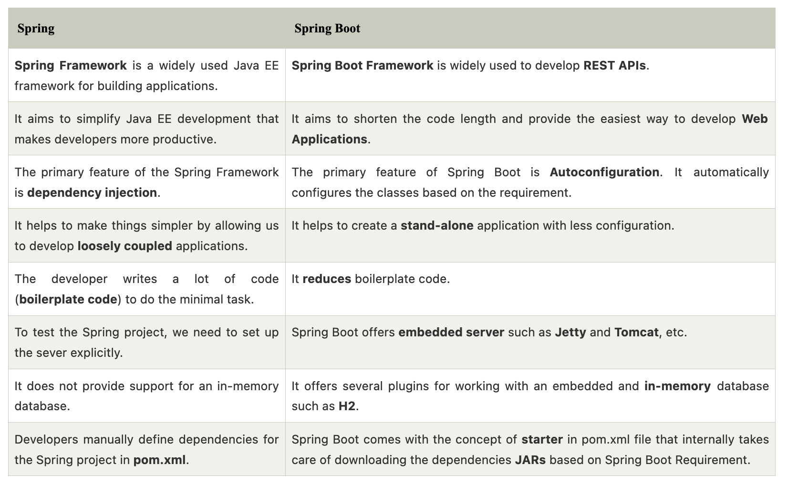

Slide 69
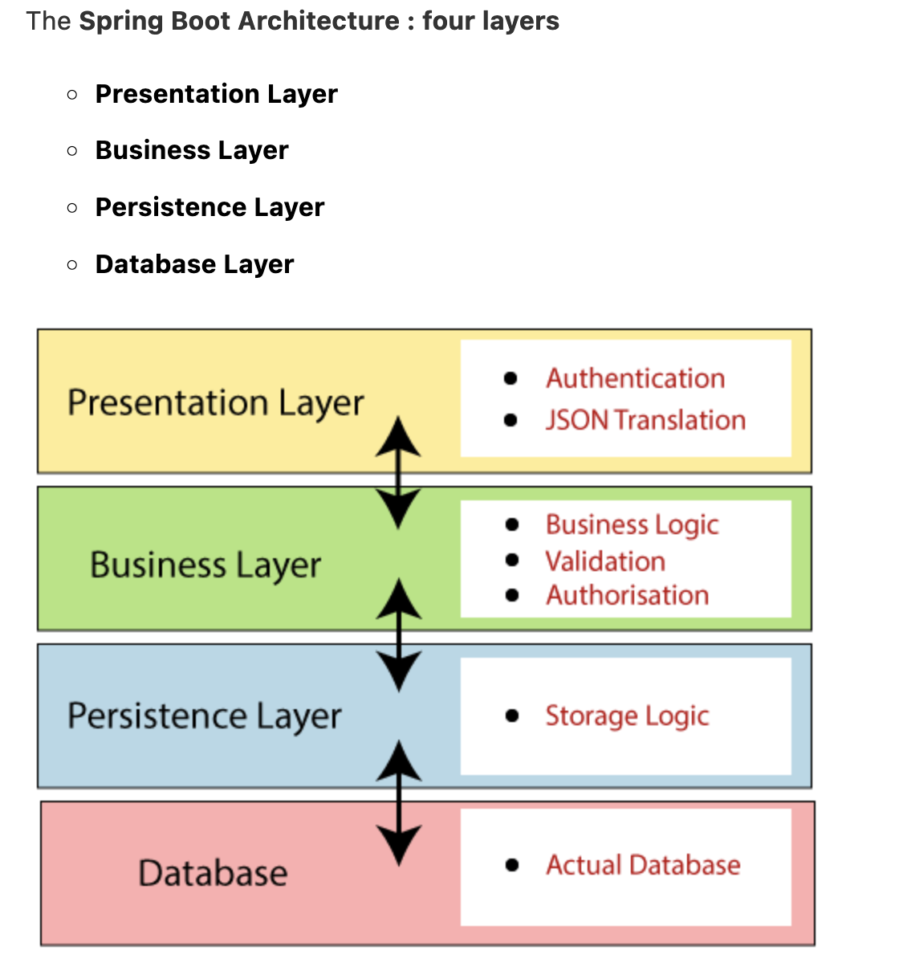
Spring Boot Architecture
Spring Boot is a module of the Spring Framework. It is used to create stand-alone, production-grade Spring Based Applications with minimum efforts. It is developed on top of the core Spring Framework.
Spring Boot follows a layered architecture in which each layer communicates with the layer directly below or above (hierarchical structure) it.

Slide 70
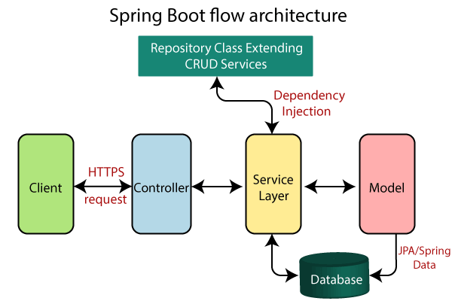
Spring Boot Flow Architecture

Slide 71
Quickstart
https://spring.io
https://spring.io/quickstart

Slide 72

Quickstart

Slide 73
Core Spring Framework Annotations
@Required | It applies to the bean setter method. It indicates that the annotated bean must be populated at configuration time with the required property, else it throws an exception BeanInitilizationException.
@Autowired | Spring provides annotation-based auto-wiring by providing @Autowired annotation. It is used to autowire spring bean on setter methods, instance variable, and constructor. When we use @Autowired annotation, the spring container auto-wires the bean by matching data-type.
@Configuration | It is a class-level annotation. The class annotated with @Configuration used by Spring Containers as a source of bean definitions.
@ComponentScan | It is used when we want to scan a package for beans. It is used with the annotation @Configuration. We can also specify the base packages to scan for Spring Components.
@Bean | It is a method-level annotation. It is an alternative of XML <bean> tag. It tells the method to produce a bean to be managed by Spring Container.

Slide 74
Spring Framework Stereotype Annotations
@Component | It is a class-level annotation. It is used to mark a Java class as a bean. A Java class annotated with @Component is found during the classpath. The Spring Framework pick it up and configure it in the application context as a Spring Bean.
@Controller | The @Controller is a class-level annotation. It is a specialization of @Component. It marks a class as a web request handler. It is often used to serve web pages. By default, it returns a string that indicates which route to redirect. It is mostly used with @RequestMapping annotation.
@Service | It is also used at class level. It tells the Spring that class contains the business logic.
@Repository | It is a class-level annotation. The repository is a DAOs (Data Access Object) that access the database directly. The repository does all the operations related to the database.

Slide 75
Dependencies
You can go ahead and add a few dependencies to be used in this project.
Spring Data JPA – Java Persistence API and Hibernate.
Spring Web – To include Spring MVC and embed Tomcat into your project.
Spring Boot DevTools – Development Tools.
MS-SQL Driver – JDBC Driver

Slide 76

Write a Rest Endpoint
To write a simple Hello World Rest Endpoint in the Spring Boot Application main class file itself, follow the steps shown below −
Firstly, add the @RestController annotation at the top of the class.
Now, write a Request URI method with @RequestMapping annotation.
Then, the Request URI method should return the Hello World string.

Slide 77
Setting Main Class
In Spring Boot, we need to mention the main class that should start in the build file. For this purpose, you can use the following pieces of code −
For Maven, add the start class in pom.xml properties as shown below −
<start-class>
demo.DemoApplication
</start-class>

Slide 78

MS-SQL driver dependency in your pom.xml

Slide 79

Sample Crud API

Slide 80
Sample of POM.XML
<?xml version="1.0" encoding="UTF-8"?>
<project
xmlns="http://maven.apache.org/POM/4.0.0"
xmlns:xsi="http://www.w3.org/2001/XMLSchema-instance"
xsi:schemaLocation="http://maven.apache.org/POM/4.0.0 http://maven.apache.org/xsd/maven-4.0.0.xsd">
….
<dependencies>
….
<dependency>
<groupId>com.microsoft.sqlserver</groupId>
<artifactId>sqljdbc4</artifactId>
<version>4.0</version>
</dependency>
<dependency>
<groupId>org.springframework.boot</groupId>
<artifactId>spring-boot-starter-test</artifactId>
<scope>test</scope>
</dependency>
</dependencies>
<build>
<plugins>
<plugin>
<groupId>org.springframework.boot</groupId>
<artifactId>spring-boot-maven-plugin</artifactId>
</plugin>
</plugins>
</build>
</project>

Slide 81

Configuring MS-SQL Server Database
Configure Spring Boot to use the Microsoft SQL server as our data source. You can do that simply by adding the Microsoft SQL database URL, username, and password in the src/main/resources/application.properties file

Slide 82
LAB
https://github.com/selimppc/spring-boot-tutorial/tree/master/springboot2-mssql-jpa-hibernate-crud-example
https://www.w3schools.blog/spring-boot-tutorial

Slide 83

Typescript

Slide 84

Typescripts

Slide 85



What is Typescripts

Slide 86

TypeScript

Slide 87

TypeScript Framework

Slide 88
SQL

Slide 89
SQL
What is SQL?
SQL stands for Structured Query Language
SQL lets you access and manipulate databases
SQL became a standard of the American National Standards Institute (ANSI) in 1986, and of the International Organization for Standardization (ISO) in 1987

Slide 90
What Can SQL do
SQL can execute queries against a database
SQL can retrieve data from a database
SQL can insert records in a database
SQL can update records in a database
SQL can delete records from a database
SQL can create new databases
SQL can create new tables in a database
SQL can create stored procedures in a database
SQL can create views in a database
SQL can set permissions on tables, procedures, and views

Slide 91

Querying Data

Slide 92

SQL ORDER BY
The ORDER BY is an optional clause of the SELECT statement. The ORDER BY clause allows you to sort the rows returned by the SELECT clause by one or more sort expressions in ascending or descending order.

Slide 93

Filtering Data
SQL DISTINCT: the SQL DISTINCT operator to remove duplicates from a result set

Slide 94

Filtering Data
SQL LIMIT : the SQL LIMIT clause to limit the number of rows returned from a query.

Slide 95

Filtering Data
SQL WHERE : the SQL WHERE clause to filter rows based on specified conditions.

Slide 96

Filtering Data
SQL Comparison Operators : The SQL comparison operators allow you to test if two expressions are the same.

Slide 97
Filtering Data
SQL Comparison Operators : The SQL comparison operators allow you to test if two expressions are the same.

Slide 98

Filtering Data
SQL Logical Operators : the SQL logical operators and how to use them to test for the truth of a condition.

Slide 99


SQL CASE expression
The SQL CASE expression allows you to evaluate a list of conditions and returns one of the possible results. The CASE expression has two formats: simple CASE and searched CASE.

Slide 100

Joining Multiple Tables

Slide 101

SQL INNER JOIN

Slide 102

SQL FULL JOIN
FULL OUTER JOIN and FULL JOIN are the same.

Slide 103

SQL LEFT JOIN

Slide 104

SQL RIGHT JOIN

Slide 105

Grouping Data
The GROUP BY is an optional clause of the SELECT statement. The GROUP BY clause allows you to group rows based on values of one or more columns. It returns one row for each group.

Slide 106

SQL UNION operator
The UNION operator combines result sets of two or more SELECT statements into a single result set. The following statement illustrates how to use the UNION operator to combine result sets of two queries

Slide 107



Modifying data

Slide 108




Working with table structures

Slide 109
Constraints
PRIMARY KEY – show you how to define a primary key for a table.
FOREIGN KEY – walk you through the steps of enforcing the relationship between data in two tables using the foreign key constraint.
UNIQUE – ensure the uniqueness of values in a column or a set of columns.
NOT NULL – ensure that the values inserted into or updated to a column are not NULL.
CHECK – validate data before it is stored in one or more columns based on a Boolean expression.

Slide 110
LAB
https://www.w3schools.com/sql/exercise.asp

Slide 111

Git

Slide 112

Git
Git is a free and open source distributed version control system designed to handle everything from small to very large projects with speed and efficiency.
Git is easy to learn and has a tiny footprint with lightning fast performance. It outclasses SCM tools like Subversion, CVS, Perforce, and ClearCase with features like cheap local branching, convenient staging areas, and multiple workflows.

Slide 113

Git - Version control
Version control, also known as source control, is the practice of tracking and managing changes to software code. Version control systems are software tools that help software teams manage changes to source code over time. As development environments have accelerated, version control systems help software teams work faster and smarter.

Slide 114


Git - Install Git and Create a GitHub Account / Gitlab

Slide 115


Git - Create a Local Git Repository

Slide 116


Git - Create a New Repository on Git

Slide 117

Git - Add a File to the Repository

Slide 118

Git - Unstage Files on Git

Slide 119

Git - Create a Commit
After adding the specified files to the staging environment, instruct Git to package the files into a commit using the git commit command. Git then stores that file version. You can review the stored version at any given time.

Slide 120

Git - Undo Last Commit

Slide 121

Git - Create a New Branch

Slide 122

Git - Switch Branches

Slide 123

Git - Rename a Local or Remote Git Branch

Slide 124

Git - Delete a Local or Remote Git Branch

Slide 125

Git - Remove a Git Remote

Slide 126

Git - Create a Pull Request
Log in to your GitHub page. There is now a Create pull request option in your repository with the branch name we created in the command line. Click the Compare & pull request button.

Slide 127

Git - Synchronize Changes Locally

Slide 128
LAB
https://www.w3schools.com/git/exercise.asp

Slide 129
Agile

Slide 130

What is Agile and its Benefits
Agile is a process that lets teams manage a project by breaking it up into several stages. It involves constant collaboration with stakeholders with constant improvement and iteration at each and every stage.
Agile methodologies enable organizations to deliver value to customers faster and with fewer complications by systematically managing projects and developing software in an iterative fashion. The approach of an agile team is to deliver work in small, but consumable, increments, rather than wagering everything on a "big bang" launch. As a result of continuously evaluating requirements, plans, and results, teams are able to respond to change in a timely manner.

Slide 131
Different types of Agile methodologies
Kanban Kanban helps project teams to execute timely production by enabling everyone to have a visibility of where the work is in the project and what is lined up next. Kanban projects are mostly managed through a Kanban Board.
Scrum This uses a Scrum Board, quite similar to a Kanban Board. It groups tasks into columns based on progress. Scrum usually breaks down a project into sprints, planning, and managing, one sprint at a time.
Extreme programming (XP) Designed for Agile software development projects, XP focuses on continuous software development and customer delivery.
Feature-driven Development (FDD) It is also one of the software-specific Agile frameworks. In this methodology, software models are created every two weeks. This requires a development and design plan for every software model feature.

Slide 132

What is Scrum
Scrum framework is used for managing product development and other knowledge-related work. It is structured in such a way that it allows project teams to incorporate best practices from other frameworks. In this lesson of the Agile Scrum tutorial, you’ll learn the A-Z of Scrum.

Slide 133

Understanding Agile Process
Agile is used for improving the project management and software development process. It helps project teams to deliver value to customers. The work provided, although small, is incremental in nature. As a result, teams are able to respond to changes quite efficiently.

Slide 134

Scrum vs. Kanban
Kanban includes visualizing all the work, limiting work in progress, and maximizing output. In Kanban, the project teams focus on reducing the project cycle from start to finish, usually by using a kanban board and continuously improving the workflow.
On the other hand, Scrum teams are committed to shipping working software through sprints. The goal is to build learning loops to collect and integrate customer feedback. Scrum project teams adopt specific roles and hold regular ceremonies to keep things moving forward.

Slide 135

Agile is a Mindset
The values and principles of the Agile Manifesto serve as the foundation for the agile mindset. These values and principles offer direction on change, react, and handle uncertainty. Try something you think might work when faced with uncertainty, get feedback, and make adjustments as needed.

Slide 136
Key Agile Concepts
User Stories: The team divides the work into functional units known as "user stories" in consultation with the client or product owner. Each user story must add something valuable to the final product.
Daily Meeting: The team meets every day at the same time to update everyone on the information necessary for coordination:
Personas: When the project requires it, the team creates in-depth, fabricated biographies of hypothetical users of the intended product.
Team: A small group of individuals assigned to the same project or effort, almost all of whom work full-time, is referred to as a "team" in the Agile context.
Incremental Development: Agile teams prefer to use an incremental development strategy, which in an Agile setting means that each iteration of the product improves on the one before it by including user-visible functionality.
Iterative development: Agile projects intentionally permit "repeating" software development activities and the potential for "revisiting" the same work products, known as iterative development.
Milestone Retrospective: After a project has been running for a while, the team dedicates one to three days to examine the key moments.

Slide 137
Agile Disadvantages
Organizational cultures can conflict with agile values
Teams may use inconsistent practices
Teams may encounter resistance from organizations to change in adoption.

Slide 138
When Should You Use Agile Project Management?
Agile is a project management approach that is better suited for ongoing projects and projects where specific details are unclear from the beginning because of its core principles, which include continuous delivery, iteration, adaptability, and short time frames, among others. Therefore, an Agile approach is a good choice for a project lacking precise constraints, deadlines, or resources.

Slide 139
Microservice

Slide 140

What are microservices?
Microservices - also known as the microservice architecture - is an architectural style that structures an application as a collection of services that are
Highly maintainable and testable
Loosely coupled
Independently deployable
Organized around business capabilities
Owned by a small team
The microservice architecture enables the rapid, frequent and reliable delivery of large, complex applications. It also enables an organization to evolve its technology stack.

Slide 141

How microservices benefit the organization
Microservices are likely to be at least as popular with executives and project leaders as with developers. This is one of the more unusual characteristics of microservices because architectural enthusiasm is typically reserved for software development teams. The reason for this is that microservices better reflect the way many business leaders want to structure and run their teams and development processes.

Slide 142

Monolith vs Microservice

Slide 143
Principles of microservices
Single responsibility: It is one of the principles defined as a part of the SOLID design pattern. It states that a single unit, either a class, a method, or a microservice should have one and only one responsibility. Each microservice must have a single responsibility and provide a single functionality. You can also say that: the number of microservices you should develop is equal to the number of functionalities you require. The database is also decentralized and, generally, each microservice has its own database.
Built around business capabilities: In today’s world, where so many technologies exist, there is always a technology that is best suited for implementing a particular functionality. But in monolithic applications, it was a major drawback, as we can’t use different technology for each functionality and hence, need to compromise in particular areas. A microservice shall never restrict itself from adopting an appropriate technology stack or backend database storage that is most suitable for solving the business purpose, i.e., each microservice can use different technology based on business requirements.
Design for failure: Microservices must be designed with failure cases in mind. Microservices must exploit the advantage of this architecture and going down one microservice should not affect the whole system, other functionalities must remain accessible to the user. But this was not the case in the Monolithic applications, where the failure of one module leads to the downfall of the whole application.

Slide 144
Advantages of microservices
It is easy to manage as it is relatively smaller.
If there’s any update in one of the microservices, then we need to redeploy only that microservice.
Microservices are self-contained and, hence, deployed independently. Their start-up and deployment times are relatively less.
It is very easy for a new developer to onboard the project as he needs to understand only a particular microservice providing the functionality he will be working on and not the whole system.
If a particular microservice is facing a large load because of the users using that functionality in excess, then we need to scale out that microservice only. Hence, the microservices architecture supports horizontal scaling.
Each microservice can use different technology based on the business requirements.
If a particular microservice goes down due to some bug, then it doesn’t affect other microservices and the whole system remains intact and continues providing other functionalities to the users.

Slide 145
Disadvantages of microservices
Being a distributed system, it is much more complex than monolithic applications. Its complexity increases with the increase in a number of microservices.
Skilled developers are required to work with microservices architecture, which can identify the microservices and manage their inter-communications.
Independent deployment of microservices is complicated.
Microservices are costly in terms of network usage as they need to interact with each other and all these remote calls result in network latency.
Microservices are less secure relative to monolithic applications due to the inter-services communication over the network.
Debugging is difficult as the control flows over many microservices and to point out why and where exactly the error occurred is a difficult task.

Slide 146

Redis

Slide 147
What is Redis
Redis an is a data structure server, Remote Data Server written in C Language.It is an in-memory database cache for storing and retrieving data. It is open-source software with an active community.
All the databases stores and retrieve the data from disk. Operation such as disk reading and writing is costly on a database. In the case of Redis, Data is read and store in the memory cache and gives the best performance.
It is easy to read and write from a programming language with few lines of code.
Even though Redis is a memory cache server, It supports deploying in a single or cluster node architecture and provides horizontal and vertical scaling. Because of this, it is highly available.
Data also can be replicated across multiple nodes in big data architecture.
It supports a different kinds of data such as String, Sets, Lists, SortedSet, Hashes, and Bitmaps.

Slide 148

Redis Features
Stores key and value pairs in memory cache
Support multiple data types data as values in pairs
Supports to store data into disk for persistence
publish and subscribe model
Master Slave Replication to have a better read access and automatic failover
Sharding for better write access
Supports scripting to have more advanced usage on how to manipulate data in memory
API to Query GEO features such as Radius

Slide 149
When to use Redis database over SQL Database?
Redis db is used in following applications
Storing user session information
short lived personalised data
Shopping cart data
Logged in user preferences

Slide 150

Difference between Redis and Memcached

Slide 151

Redis Cli Commands
Redis CLI is an command line interface that connect to Redis server to read,update and store the objects. It opens interactive shell promt and executes commands

Slide 152
Distributed System

Slide 153

What is Distributed Systems
A distributed system provides a computing environment where multiple components are linked across many computers over the network. These systems make communication along with each other and manage processes together

Slide 154

Centralized System
A centralized system consists of a single machine.
All calculations are done by a particular computer.
Its performance is low as the workload is not divided.
There is also no machine present in backup if the original computer system fails.

Slide 155

Distributed Systems
A distributed system consists of multiple machines.
All computation work is divided among the different systems.
Its performance is high as the workload is divided among different computers to efficiently use their capacity.
There are systems present in backup, so if the main system fails then work will not stop.

Slide 156
Distributed Systems
A distributed system consists of multiple machines.
All computation work is divided among the different systems.
Its performance is high as the workload is divided among different computers to efficiently use their capacity.
There are systems present in backup, so if the main system fails then work will not stop.

Slide 157

Architecture Styles
1. Layered Architecture:
In Layered architecture, different components are organised in layers. Each layer communicates with its adjacent layer by sending requests and getting responses. The layered architecture separates components into units. It is an efficient way of communication. Any layer can not directly communicate with another layer. A layer can only communicate with its neighbouring layer and then the next layer transfers information to another layer and so on the process goes on.

Slide 158

Architecture Styles
2. Object-Oriented Architecture:
In this type of architecture, components are treated as objects which convey information to each other. Object-Oriented Architecture contains an arrangement of loosely coupled objects. Objects can interact with each other through method calls. Objects are connected to each other through the Remote Procedure Call (RPC) mechanism or Remote Method Invocation (RMI) mechanism. Web Services and REST API are examples of object-oriented architecture.

Slide 159

Architecture Styles
3. Data Centred Architecture:
Data Centred Architecture is a type of architecture in which a common data space is present at the centre. It contains all the required data in one place a shared data space. All the components are connected to this data space and they follow publish/subscribe type of communication. It has a central data repository at the centre. Required data is then delivered to the components. Distributed file systems, producer-consumer systems, and web-based data services are a few well-known examples.

Slide 160

Architecture Styles
4. Event-Based Architecture:
Event-Based Architecture is almost similar to Data centred architecture just the difference is that in this architecture events are present instead of data. Events are present at the centre in the Event bus and delivered to the required component whenever needed. In this architecture, the entire communication is done through events. When an event occurs, the system, as well as the receiver, get notified. Data, URLs etc are transmitted through events. The components of this system are loosely coupled that’s why it is easy to add, remove and modify them. Heterogeneous components can communicate through the bus.

Slide 161


Slide 162
Thank You

